Slide 1
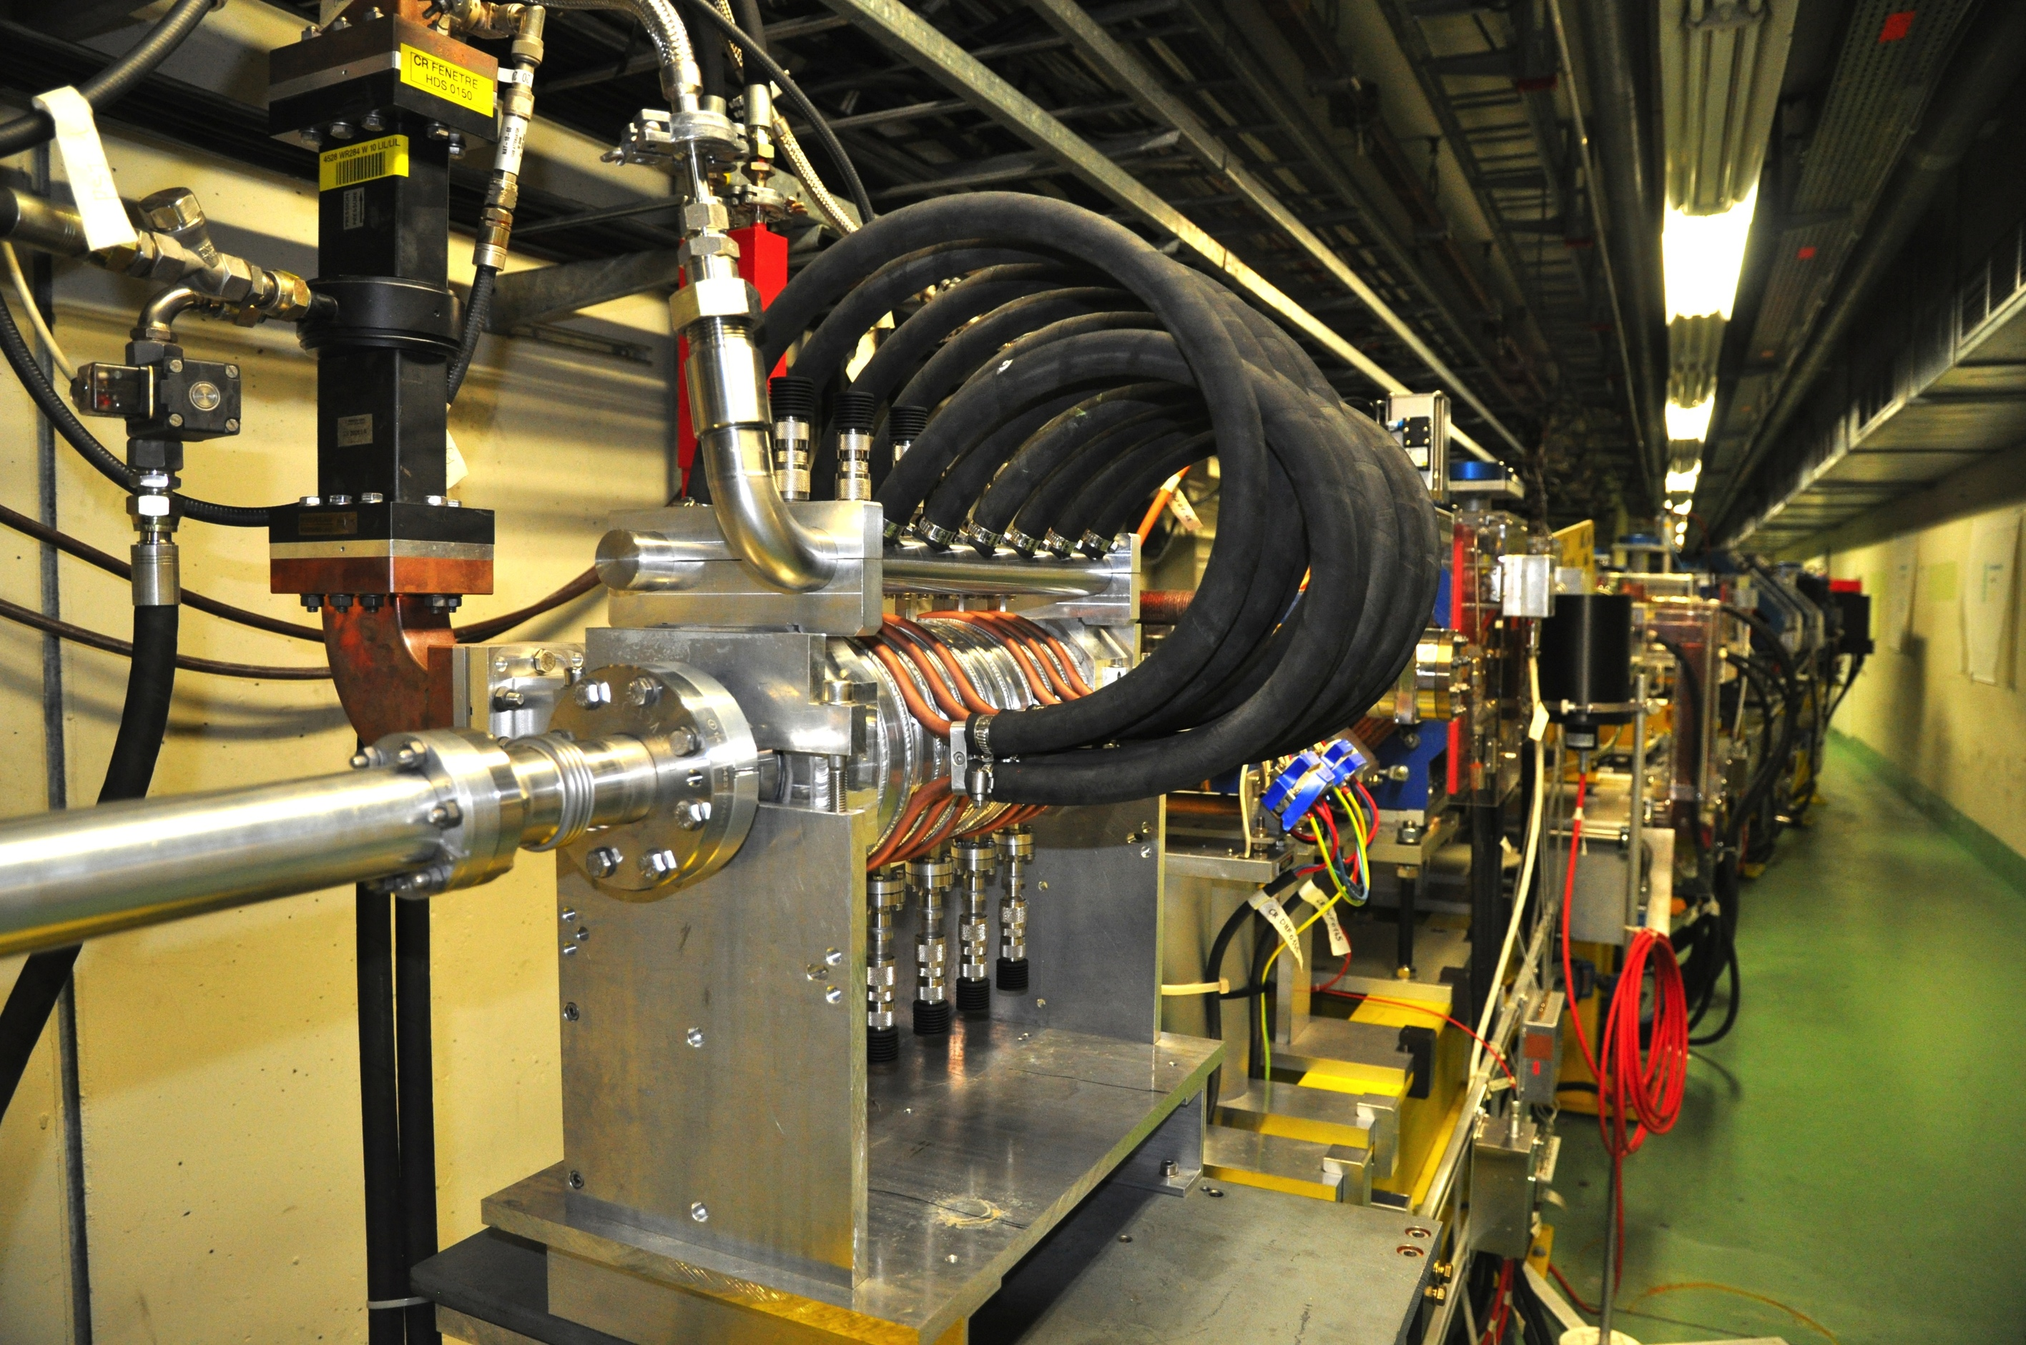


The future of CTF3
R. Corsini

Slide 2
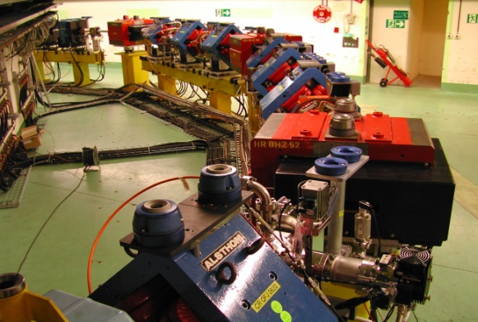
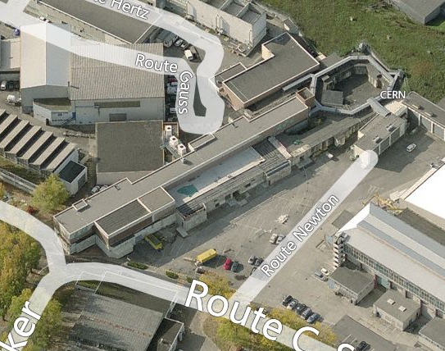
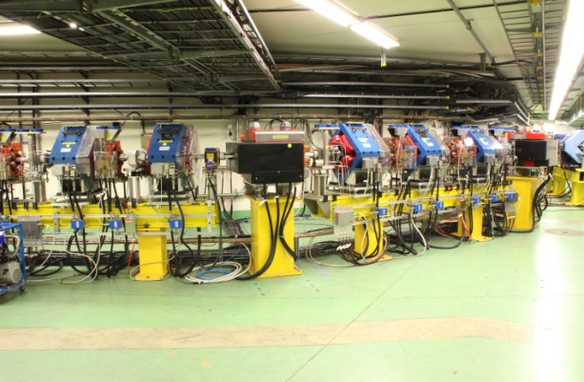
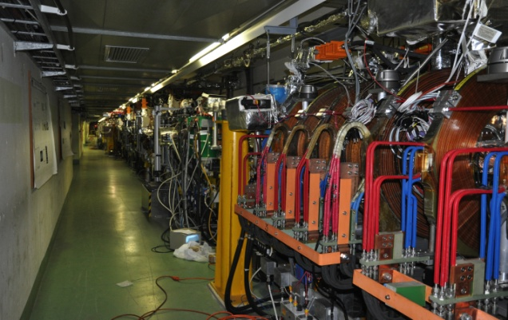
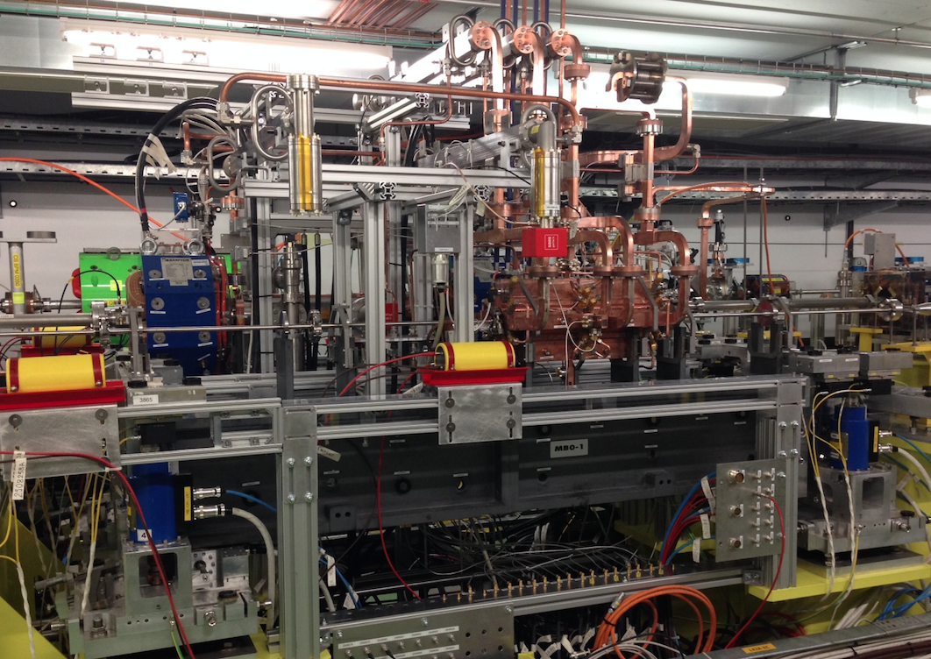
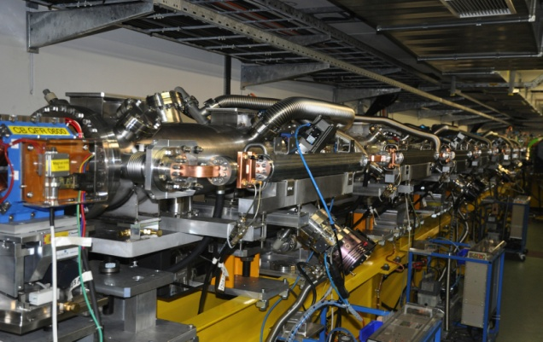
CLIC Test Facility (CTF3)
DELAY LOOP
COMBINER
RING
CLEX
DRIVE BEAM LINAC
TBL
Two Beam Module

Slide 3
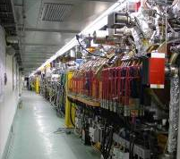
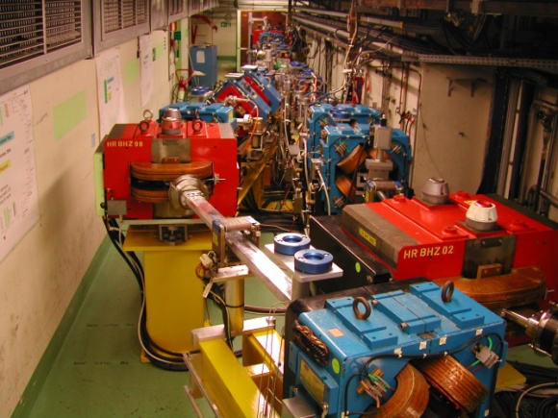
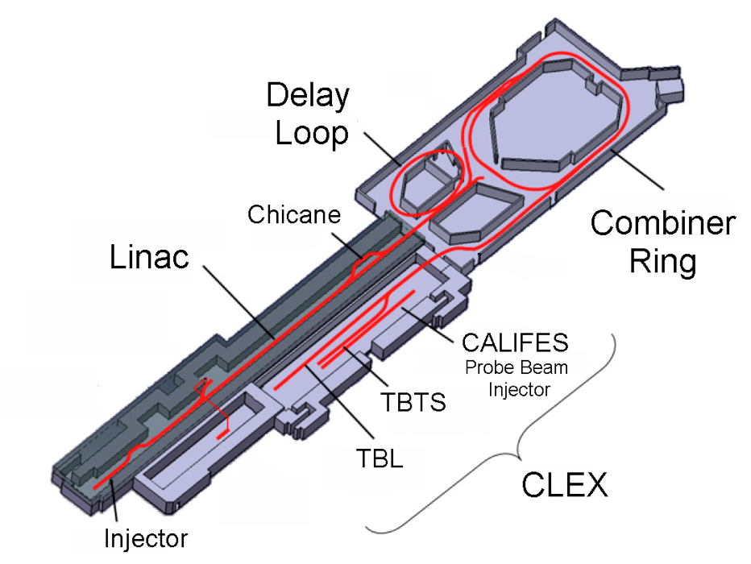
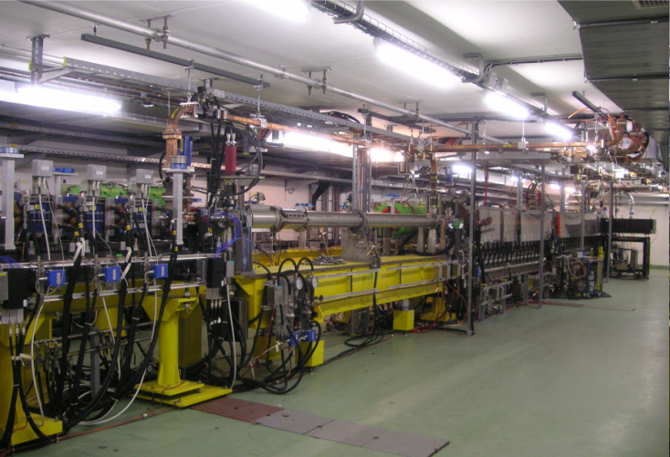
CLIC Test Facility (CTF3)
Operation of isochronous lines and rings
4 A, 1.4us
120 MeV
30 A, 140 ns
120 MeV
High current, full
beam-loading operation
Beam recombination & current multiplication by RF deflectors
12 GHz power generation by drive beam deceleration
High-gradient
two-beam acceleration
PETS ON/OFF
30 A, 140 ns
60 MeV
Bunch phase coding

Slide 4
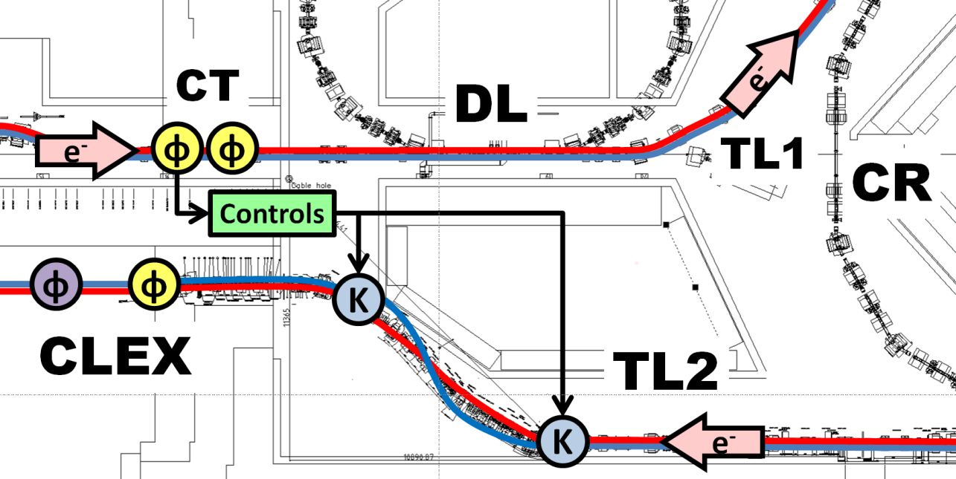
The next two years…
Phase feed-forward experiment
Diagnostics R&D using CALIFES
Dogleg Beam loading experiment
Two Beam Module,
Wake-field monitors…
TBL deceleration

Slide 5
CLIC system tests beyond CTF3
S. Stapnes
Drive beam R&D beyond CTF3
  RF unit prototype with industry using CLIC frequency and parameters
  Drive beam front-end (injector), to allow development into larger drive beam facility beyond 2018
Damping rings
  Tests at existing damping rings, critical component development (e.g. wigglers) ... large common interests with light source laboratories
Main beam
  Beam based alignment tests at FACET, FERMI, …
Beam Delivery System
  ATF/ATF2

Slide 6
Context
CTF3 went well beyond its initial task of demonstrating CLIC two-beam scheme feasibility
Has a well established scientific program until end 2016
Definitely want to stop CTF3 after that (limited resources…)
➔ What to do with CTF3 hardware & building?
Discussions started beginning 2014. Current main proposals:
  ➔ Install new DB front-end in CTF3 linac area (CLIC related).
  Keep using CALIFES linac in CLEX for as a general test facility after 2016. Possibly interesting beyond CLIC scope (in CERN and outside).
  Last discussions at LCWS 2014 – Belgrade & CLIC Project Meeting:
  https://agenda.linearcollider.org/event/6389/session/18/#20141009
  http://indico.cern.ch/event/356495/

Slide 7
Rationale for uses of CTF3 hardware beyond 2016
CLIC Collaboration interest: keep beam test capability for CLIC (diagnostics, components…) locally at CERN after CTF3 stop
Some additional points:
  Possibility of beam tests during long shut-downs
  Keep experimental electron expertise alive at CERN, including laser and photo-cathodes – link with AWAKE
  Complement high-gradient X-band activities for X-FELs, medical…
  Provide training ground for young accelerator physicists at CERN and collaborating institutes
➔ Find synergies with other potential partners (project/groups within and outside CERN) in order to gather enough resources and get approval from CERN management

Slide 8
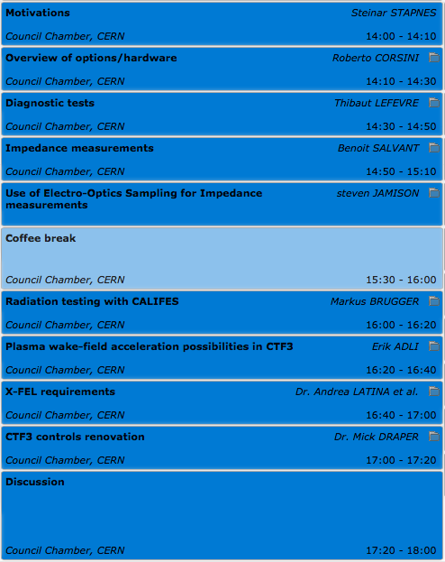
Tuesday session on Future tests beyond CTF3:
Scope and aim
Concentrate mainly on CALIFES based proposals
Review proposals and identify needs (basic and advanced), both in terms of beam parameters and for operation/hardware/infrastructure
Try to define a list of beam parameters and of space/hardware requirements capable to satisfy most of the users
Discuss and if possible decide on next steps needed to arrive at a proposal

Slide 9
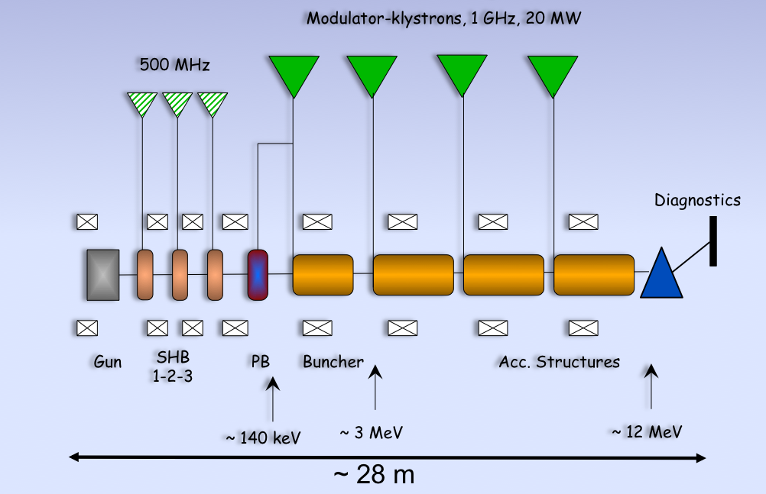
Drive Beam Front-End
The drive beam front-end in the CTF3 building – F. Tecker, LCWS2014
http://agenda.linearcollider.org/event/6389/session/18/contribution/114/material/slides/0.pptx
Same peak current than present CTF3 injector (4 A)
Longer pulse (140 us instead of 1.4 us)
Higher rep rate possible (up to 50 Hz)
Option: keep operational also (part of) the present 3 GHz linac.
Will enable beam energies up to ~ 100 MeV with limited pulse length( ~ 4 us max).

Slide 10
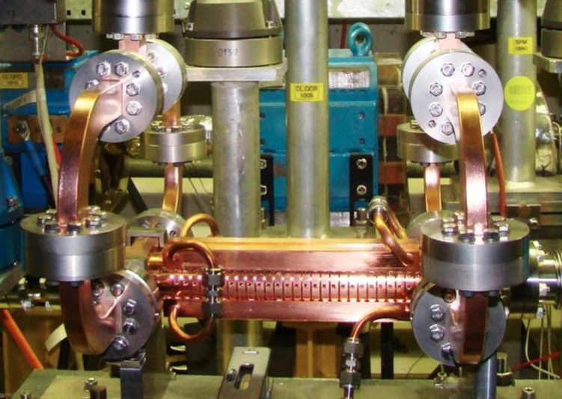
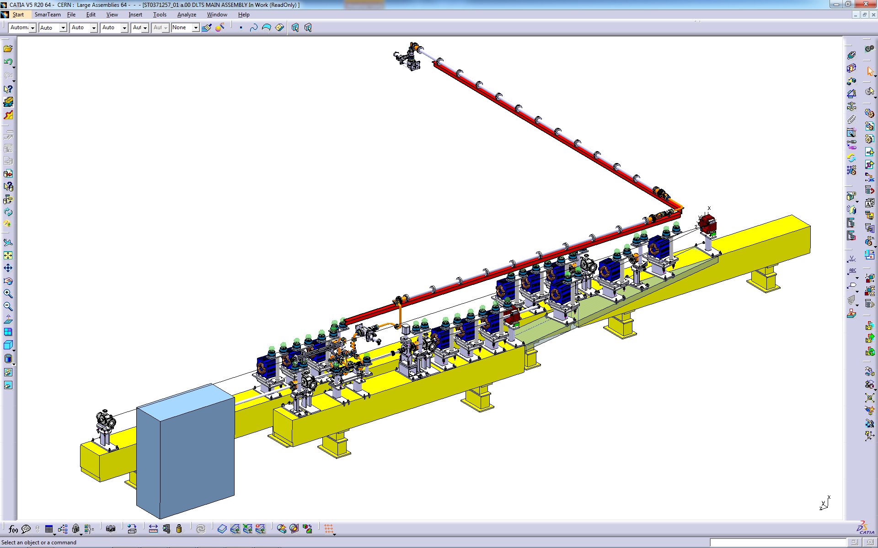
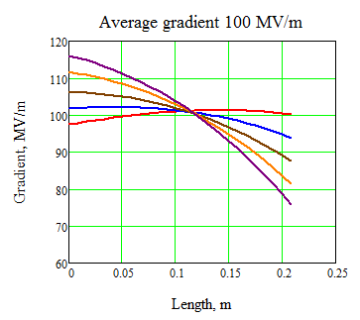
Beam Loading experiment - run beyond 2016?
Before 2016 ~ 3 test slots (one per year) – not a large statistics
In this time scale could have a new CLIC structure prototype from re-baselining, may want to test it
Want to explore structures with different (tapered-up) gradient profile
Other potential users?
Need relative small part of infrastructure – 5 MKS, first 50 m of linac / Compatibility with Front-end?
DELAY LOOP
BL - BDR experiment
COMBINER RING
LINAC
CLEX
From XBOX-1
RF
Gradient along the structure
∅ 50 mm circular waveguide
Unloaded
Average gradient 100 MV/m
Increasing current
Drive beam, 1-3A, 100-50 MeV
Loaded (CLIC)
T24 structure installed in CTF3

Slide 11
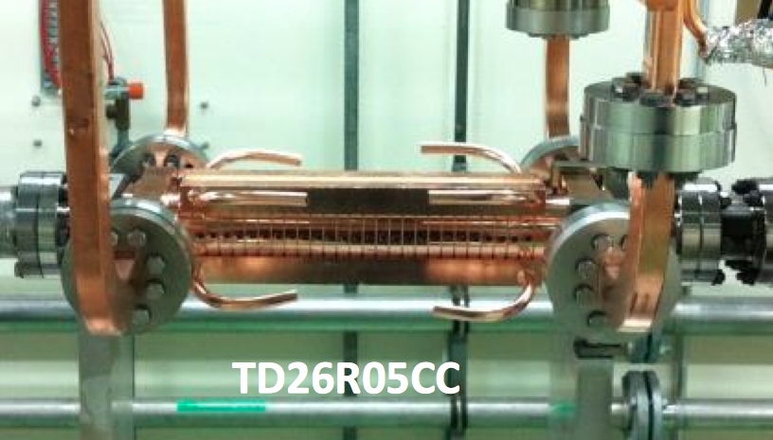
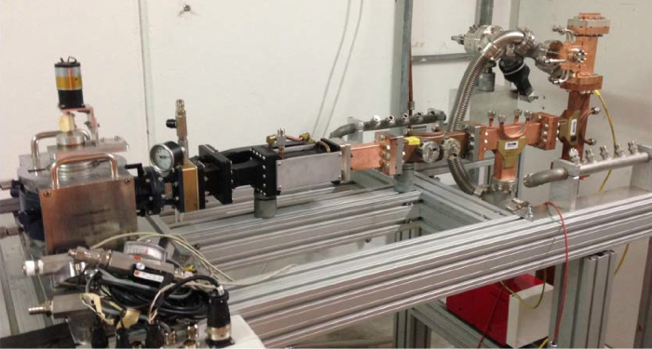
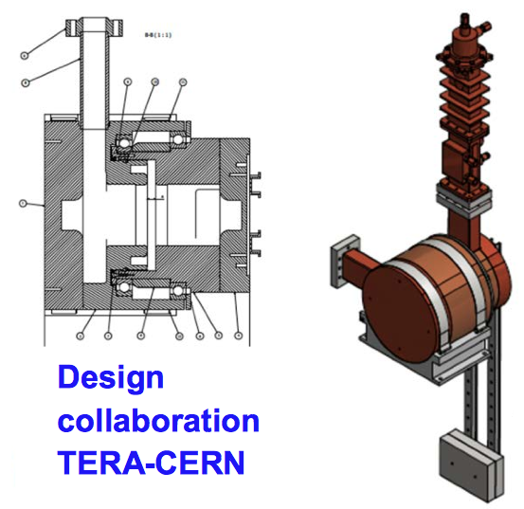
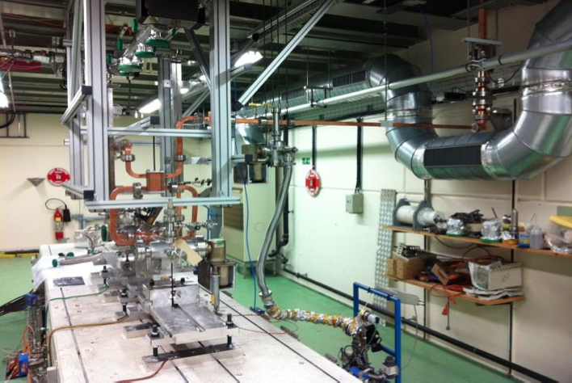
Former CTF2 area, X-band and S-band RF testing
X-band test area, connected to XBOX1
Used also for 3 GHz structure and component testing (TERA, ADAM…)
XBOX1 will stay, keep using the area also for 3 GHz
Compatible with other options

Slide 12
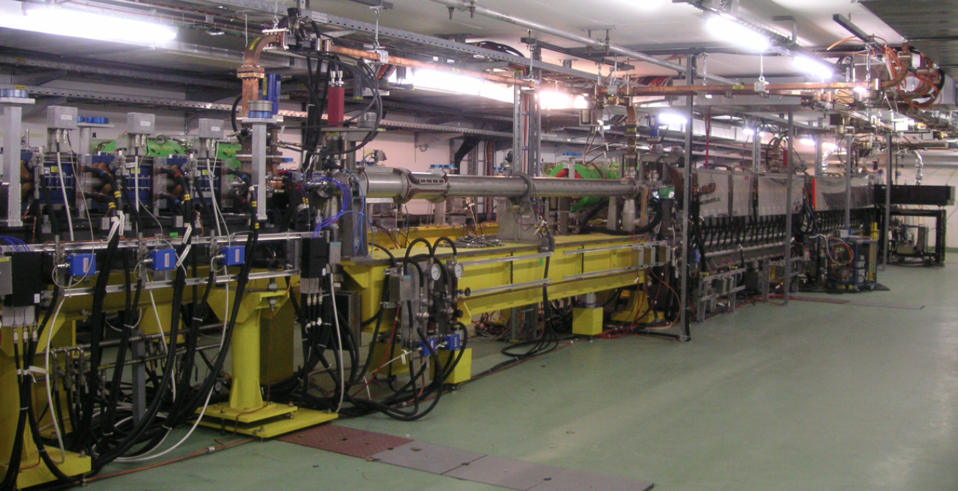
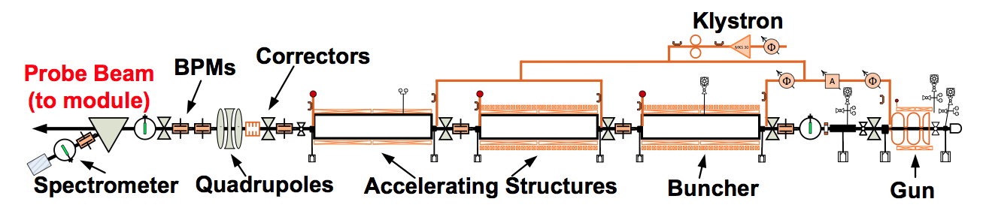
CALIFES

Slide 13
CALIFES Beam parameters
  0.01-1.5 nC bunches, 1.5 (3) GHz spacing (0.667 ns/0.333 ns)
  From single bunch to 200 ns train
  Rep rate 1-10 Hz
  Energy 150 - 200 MeV
  Normalized emittance 4 μm
  Energy spread ± 0.5 %
  Bunch length 1-2 ps and above
  May provide lower energy (>10 MeV), need to study transport
  Typical beam sizes 0.25 × 0.25 mm, uniform beam sizes obtained up to now 5 mm × 5 mm, up to few cm surely feasible.

Slide 14
Potential interests for CALIFES based test facility
Diagnostics R&D with beam tests (for CLIC, LHC & injectors, AWAKE…)
X-band structure testing with beam (X-FEL, medical applications, wake-field monitors, deflecting cavities…)
  Impedance and wake-field measurements of components (LHC, CERN Injectors, HL-LHC, CLIC… for Cavities, diagnostics equipment, collimators, kickers…)
Irradiation tests (ESA/JUICE Mission, CERN and others…)
Plasma wake-field acceleration
Beam tests of hardware (kickers, SC RF cavities)
Other medical applications (X-ray imaging, therapy with e-, isotopes production…)
Test beam for detectors
Vacuum related tests
…

Slide 15
CALIFES for diagnostics R&D - Why
T. Lefevre
Machine operation schedule @ CERN
  Long periods without the capability of performing beam tests
  Limited beam time available for Machine Developments combined with a high number of requests
Hardware installation periods are limited
  Any further improvements/modifications can not be implemented quickly
    Testing at Independent Facility will faster the developments and ensure that we installed well-understood devices on operation machine
Developing new concept versus Reliable operation
  Operational machine have strict requirements in terms of vacuum-outgassing performance/ bakeability not always compatible with R&D needs
    e.g. Testing gas ionization monitor and their performance as function of gas pressure

Slide 16
What for
CERN accelerators
  LHC, HL-LHC, LIU (SPS, PS, PSB) projects
  CLIC/ILC, AWAKE, FCC studies
Future Challenges in Beam Instrumentation
  Unprecedented request for precision
    Positioning down to below the micron level
  Treatment of increasingly more data
    Bunch by bunch measurements for all parameters:: Test of state of the art acquisition system (electric or optical domain)
  Dealing with high beam powers
    Non-invasive measurement techniques (Gas profile monitor, Quadrupolar PU, ..)
    Robust and reliable machine protection and beam loss monitoring systems
  Dealing with the (ultra) fast
    Sub-picosecond bunch lengths in AWAKE and CLIC
    Longitudinal tomography in LHC (picosecond range)
    Fast transverse beam position monitors (HL-LHC Crab cavities and transverse beam Instability diagnostics)
T. Lefevre

Slide 17
What for
T. Lefevre
A Test facility can not address all specific issues. But ….
System performance under realistic conditions that are not easily achievable in laboratory
  Test with realistic signals state of the art electronic
    i.e. Response to short pulses with high signal amplitude
  Test of UV, optical, X-ray monitors where no other source can reproduce beam induced radiation
    Imaging technique and Beam halo monitoring
    Use of electro-optical crystal
  Validation of particle detector design (e.g. Beam loss monitor/ Luminosity monitor)
    Sensitivity checks, linearity (or non-linearity) checks, ..
Study the behavior of devices with respect to beam position / bunch length / bunch intensity variations

Slide 18
How
T. Lefevre
Electron linac is the cheapest way to provide relativistic beams
  Beam energy higher than 200MeV (3.5GeV max) – similar γ as on SPS (LHC)
Photo-injector provides a modular bunch spacing
  Single bunch capability
  Bunch spacing similar to CERN beams (1ns, 5ns, 25ns, 50ns, .. )
  Pump – probe experiment (wake-field study, impedance measurement, ..)
Simplicity, Reliability and Flexibility
Wish list for Beam parameters
  Good emittance to reach small beam size (<50um)
  Short and long bunches (100fs up to 200ps)
  Large range of bunch intensity
  Possibility to study time to position correlation (Crabbing)
Slightly modified version of CALIFES
Applications requiring high beam current would require Drive Beam Injector (Beam heating studies, ..)

Slide 19
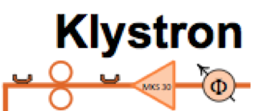



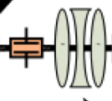
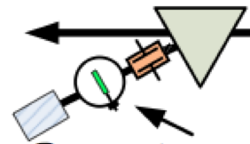

Future CALIFES – minimum configuration
Present
Future: CALIFES for beam instrumentation test
Test Area
Spectrometer
  Add an available S-band klystron + modulator
    More RF power (beam energy), more flexibility (power in 1st structure, phase in structures 2 and 3), possibility of running without RF pulse compression
  Reconfigure present TBM area as test area
  Most (all) hardware already existing
Perspectives for a CALIFES test facility beyond 2016 – R. Corsini, LCWS2014
http://agenda.linearcollider.org/event/6389/session/18/contribution/115/material/slides/0.pptx

Slide 20
“Ultimate” test area layout to cover BI needs
T. Lefevre
Collimator
- Reduce the bunch intensity before the DUT zones
- Reduce bunch length further in combination with RF deflector
RF deflector
for crabbing
Time to position correlation
Magnetic chicane
Shorten or lenghthen
100fs up to 200ps
Synchrotron radiation test stand
Under vacuum DUT area
Synchrotron radiation test stand
In-air DUT area
DUT: Device under Test

Slide 21
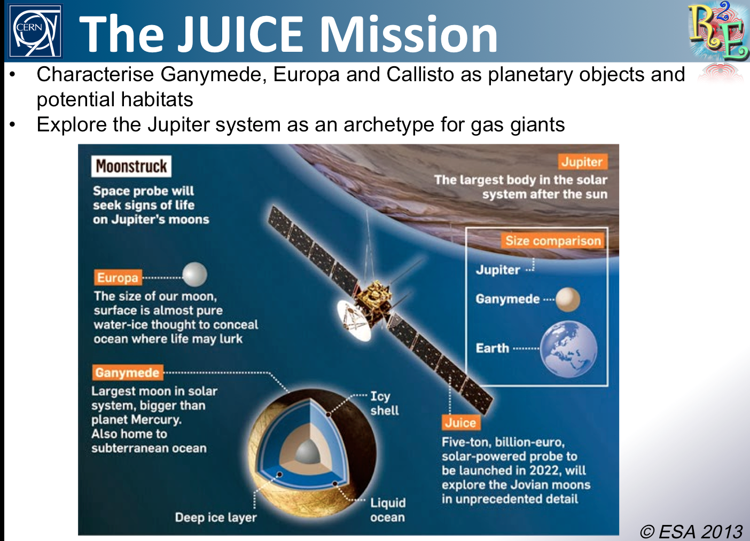
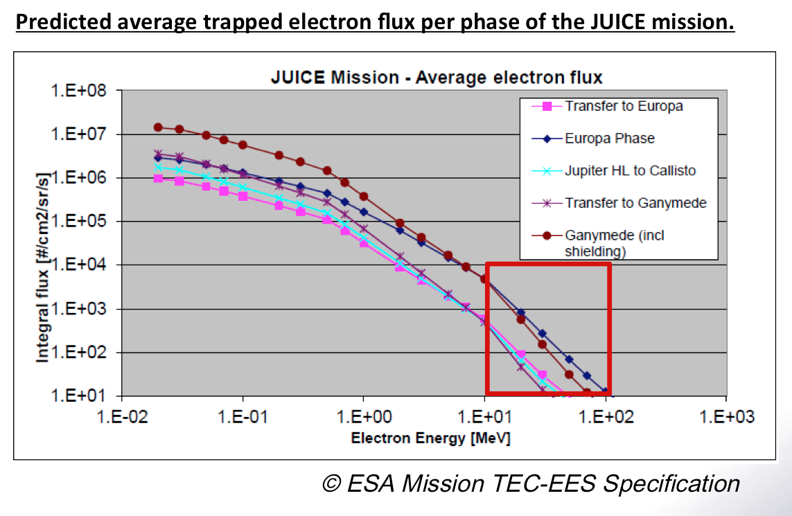
Irradiation testing with CALIFES
M. Brugger,
R. Garcia Alia

Slide 22
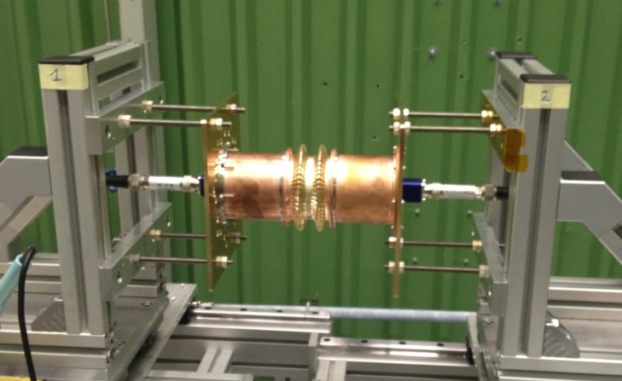
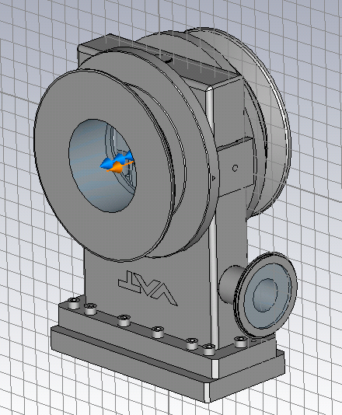
Impedance measurements - Context
B. Salvant - CERN
Impedance team involved in design and approval of new and modified equipment in all CERN circular machines (in particular PSB, PS, SPS and LHC, but also AD, ELENA and CLIC damping rings).
Tools at our disposal:
    Bench measurements with wires and probes
    → problem: not direct measurement of
    impedance or wake, and possibly strong
    perturbation of the EM fields
    Numerical simulations
    → problem: difficulty to reproduce reality with
    a model (e.g. design errors, small features,
    coatings, matching errors) , simulated exciting
    bunch is not a delta function.
→ Measurement with electron bunches could be an interesting complement to these existing tools

Slide 23
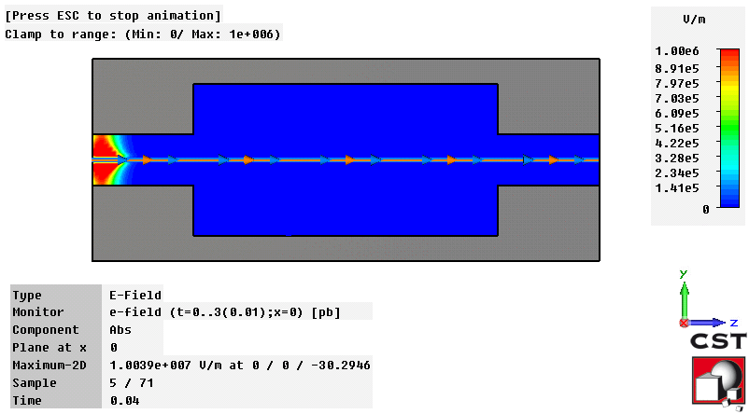
Direct measurement of generated electromagnetic fields
Possibility to measure EM fields from available
antennas, buttons, striplines, wires, all mode couplers
already in the device (or installed just for that reason).
→ See also proposal of electro optical pickup
Indirect measurement in principle, but possibility of direct benchmark of CST Particle Studio simulations with fields monitors and check their validity
→ probe measurements only validate the Qs from eigenmode simulations
→ wire measurements can perturb significantly the modes.
→ real interest in using an electron source
For the case of the wirescanners for instance, possibility to directly measure the signals that we need
→ current induced by the beam → beam induced heating
→ would be very important, and the only direct way of measuring the heat load to the wire (besides installing it in the SPS or the LHC).
For other devices, it would be an indirect measurement that could validate the model, meshing and simulation.
Source bunch
RF pickup
Simple measurement, would not need any additional hardware
Requires pre installation of a probe in the device (if there is not already one).
Switch from ferrite damping to coupler damping is proposed to avoid beam induced heating
B. Salvant - CERN

Slide 24

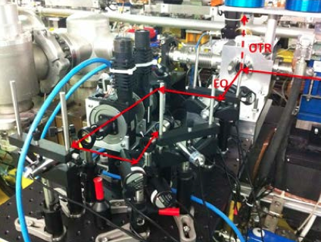
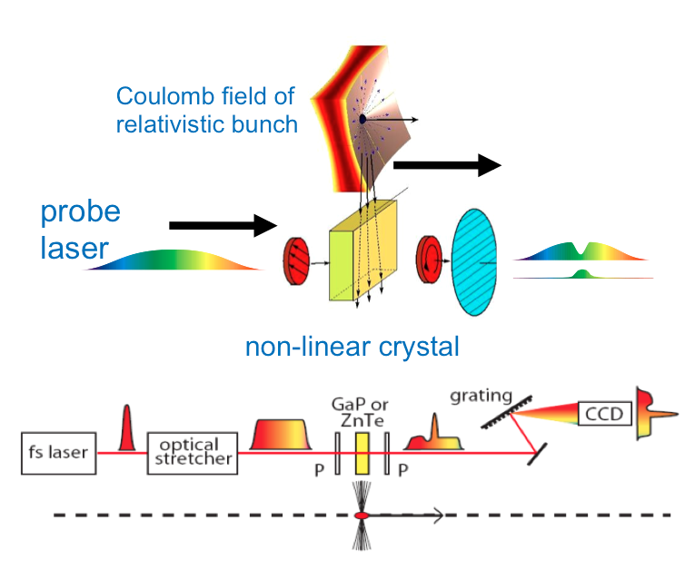
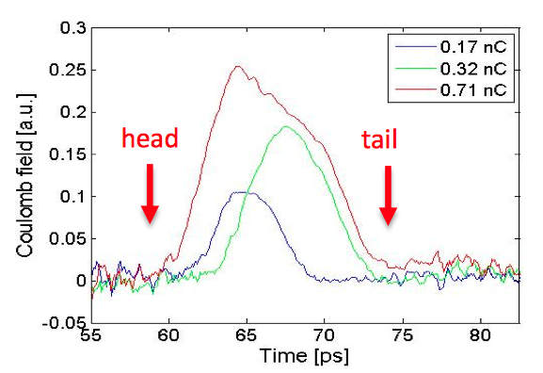

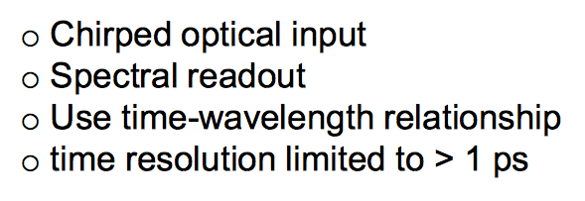
Electro-optic Diagnostics for Wake-field Characterisation
S. Jamison
ASTeC - Daresbury National Lab
CALIFES EO Test

Slide 25
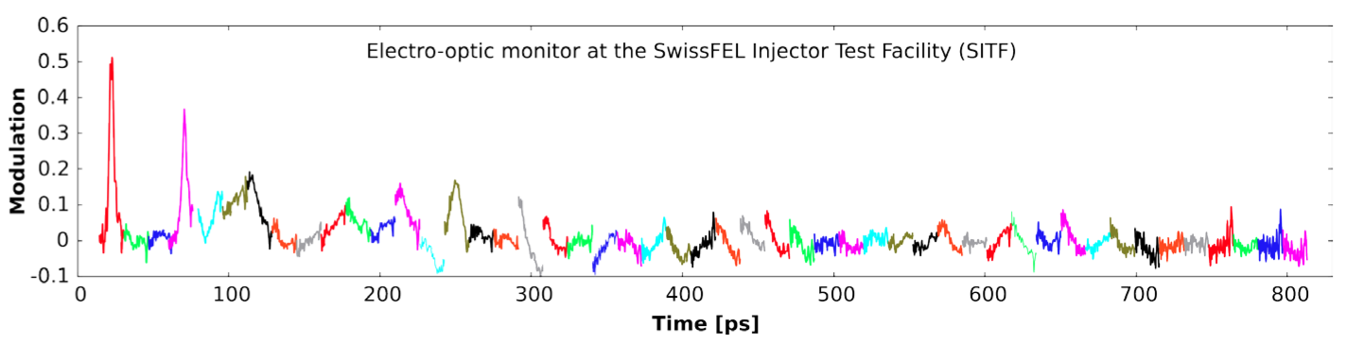

EO measurement of wake fields in
Swiss Injector test facility
S. Jamison
ASTeC - Daresbury National Lab

Slide 26
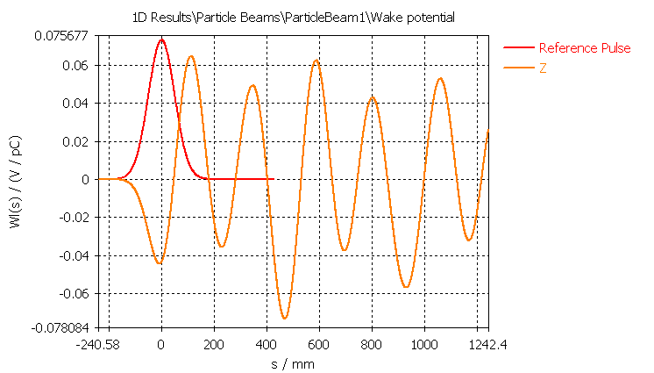
Direct measurement of “wake function”
B. Salvant - CERN
Measurement of energy loss as a function of source/test bunch spacing → longitudinal wake
Measurement of kick as a function of source/test bunch spacing → transverse wake
In simulations, difficult to reach source bunch below 1 mm for standard devices due to mesh size.
Very small bunch length achievable with electron beams (2 to 3 ps in CALIFES)
→ “wake function” could be measured provided the sampling is sufficient. Feasible?
Source bunch
Test bunch
Test bunch
Source bunch
Bunch spacing

Slide 27
Direct measurement of “wake function”
B. Salvant - CERN
Important to disentangle the “dipolar” impedance contribution from the “quadrupolar” contribution to assess the impact on collective effects
Driving impedance contribution
Detuning impedance contribution
Test bunch
Source bunch
Test bunch
Source bunch
x_{test}=0
x_{source}=d
x_{test}=d
x_{source}=0
Bunch spacing
Bunch spacing
All particles in the test bunch receive the same kick
Coherent effect
Drives instabilities
All particles in the test bunch receive a kick proportional to their position
Incoherent effect
Impact on instability depends on the type of instability
→ Can the orbits of the source and test bunches be controlled separately?

Slide 28
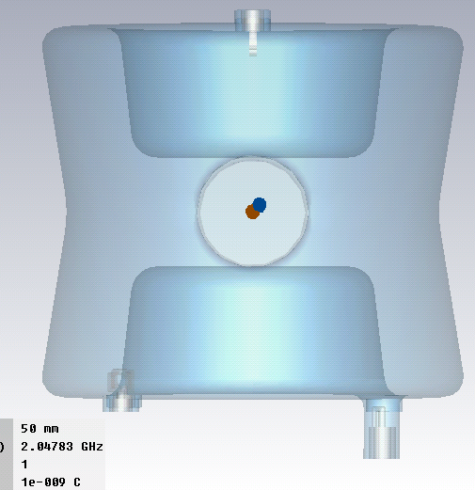
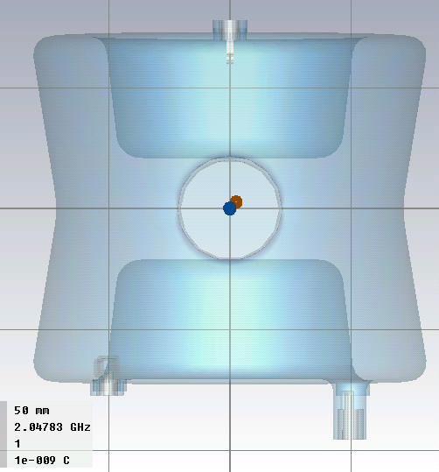
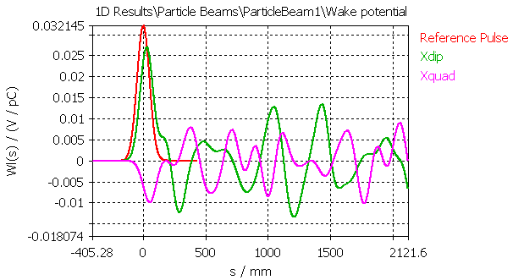
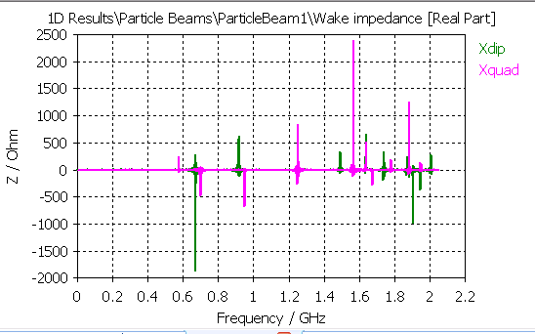
Example: LHC crab cavities
B. Salvant - CERN
Driving impedance
(also called
dipolar impedance)
Detuning impedance
(also called quadrupolar
impedance)
Wake potential
Impedance
Very different features between driving and detuning impedance and very different effects.
Detuning impedance generally small for cylindrically symmetric structures
Detuning impedance is very significant for SPS kickers (for instance) and tricky to obtain from wire measurements
Need to control separately source and test bunches

Slide 29
Potential limitations
B. Salvant - CERN
Minimum kick strength observable with the BPM resolution
    Many components are in the 1 to 10 kOhm/m range for the transverse impedance, in the mOhm range for the longitudinal impedance
    Previous studies show that the kick is of the order of 10 microns after 1 m for 10 kOhm/m
    Roberto Corsini proposed possibilities to amplify this kick using lever arms
    This could require 3 BPMs before the device and 3 BPMs after the device (H. Schmickler)
    Reducing the energy of the test bunch would help!
Need to disentangle between the test and source bunch
    Can we resolve 0.1 ns between two bunches? Challenging together with resolution requirements
    Would need special BPM development
    Could a high bandwidth kicker be used (prototype installed in SPS to work in GHz range)?
Accurate control of the orbit and spacing of test vs source
→ difficult to do with one electron source, contrary to FACET
→ ideas to delay the bunch, delay the laser pulse to control the spacing
→ ideas to move the laser pulse transverse position to control independently the transverse position
→ this could be the main limitation for the setup
Control of intensity of both bunches (highest on source and low on test)
Available length (for both device installation and for observation)
→ some critical elements are very long (SPS septa, LHC TDI and kickers).
Need for large flexibility in length and radius of input device
→ the facility may become a tapering factory.
Contribution from the BPMs and tapers should not dominate (from 40 mm/20 mm radius to the aperture of the element)

Slide 30
Table of “ideal” requirements (draft, for discussion)
B. Salvant - CERN
 | Direct measurement | Wake function reconstruction
Intensity of the source bunch | ~1 nC | ~1 nC
Intensity of the test bunch | - | Not critical
Number of bunches | - | At least 2 bunches
Minimum bunch spacing | - | 0.1 ns – 0.3 ns
Maximum bunch spacing | - | 25 ns – 1 ms
Sampling in bunch spacing | - | 0.1 ns within the first 5 ns, 0.3 ns after the first 5 ns
BPM resolution (time) | - | 0.1 ns - 0.3 ns
BPM resolution (position) |  | 1 micron
Source bunch energy | - | 200 MeV
Test bunch energy | - | Would help if lower than 200 MeV
Available installation length | 1.5 m for devices + 1 m for taper = at least 2.5 m | At least 2.5 m

Slide 31
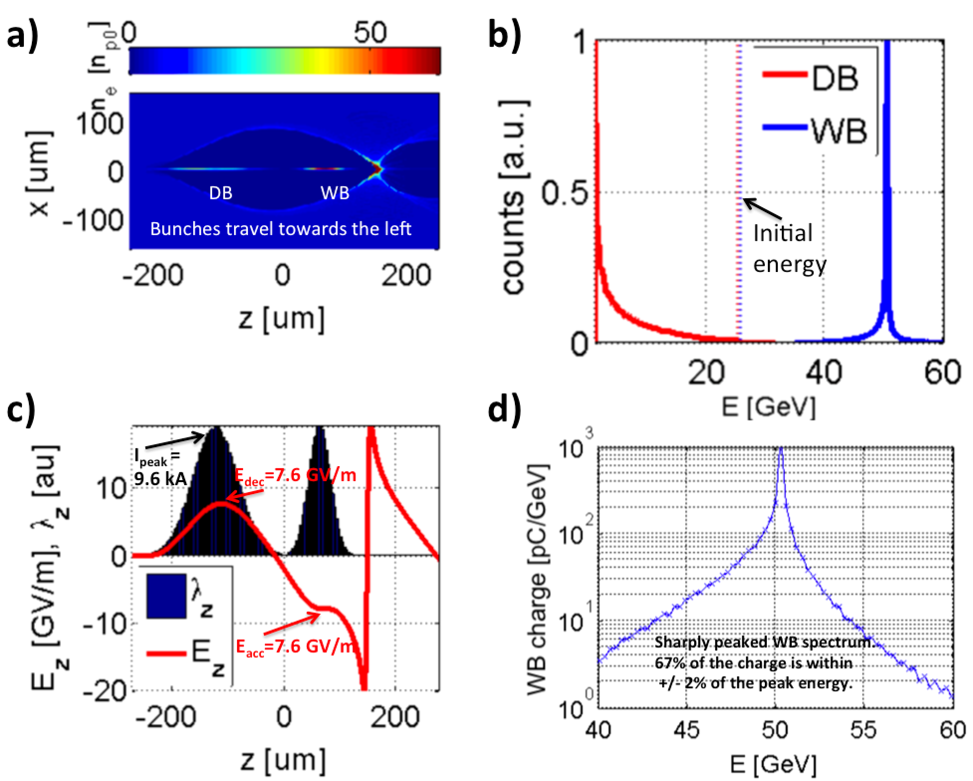
Beam driven PWFA
E. Adli – Oslo University
Beam driven PWFA:
Two-bunch acceleration. A drive bunch drives a plasma wake, being decelerated. A witness bunch extract the wake energy, being accelerated.
PWFA has potential for:
High gradient (>10 GV/m)
High efficiency (>50%)
Low energy spread (<1%)
High charge (~nC)
Emittance preservation
Above: PIC simulation based on example parameters from the PWFA-LC design study.
Not discussed here: laser driven plasma wakefield acceleration.
PIC simulations performed with the code QuickPIC (W. An, W. Mori, UCLA)

Slide 32
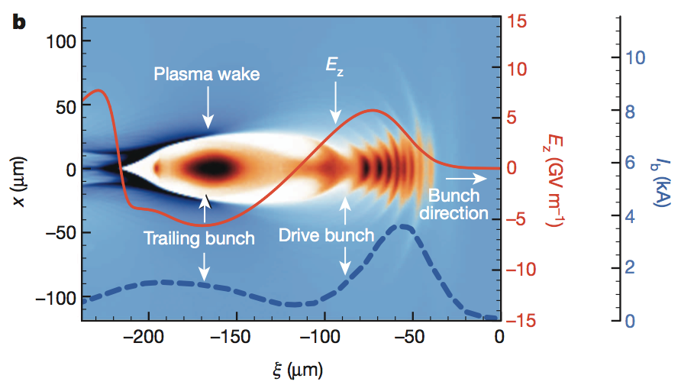
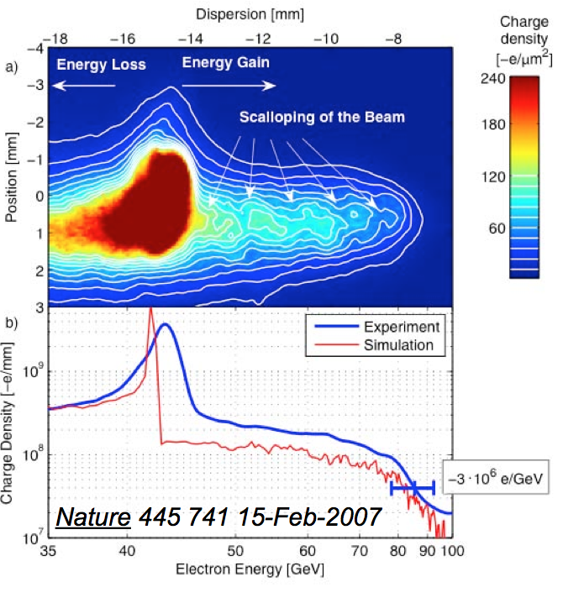
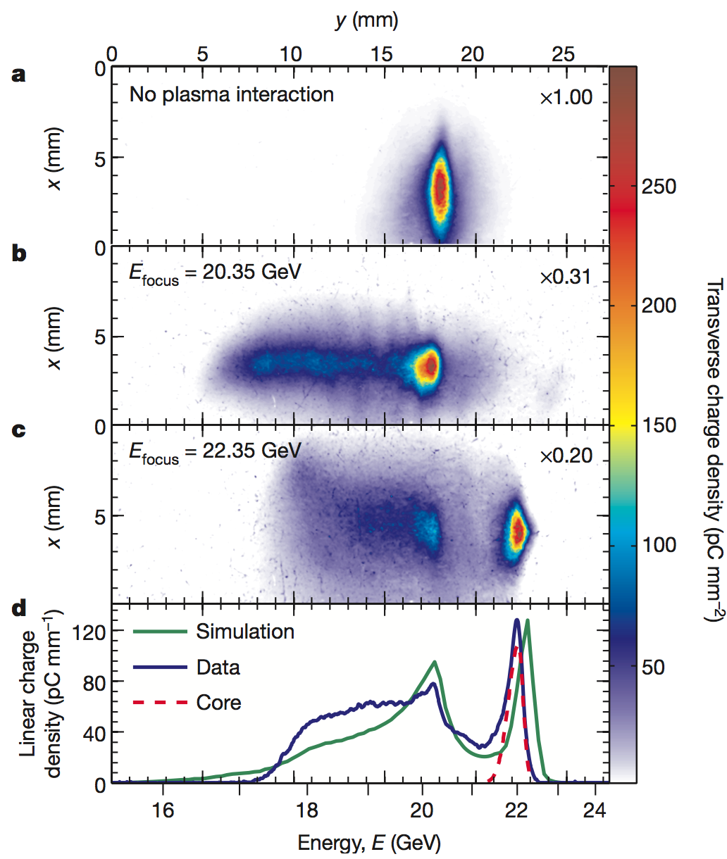
Experimental progress in PWFA
E. Adli – Oslo University
High gradient (~50 GV/m) demonstrated several years ago; SLAC linac energy doubling of beam tail.
Blumenfeld, I. et al. Nature 445, 741 (2007).
M. Litos et al., Nature 515, 92 (2014)
Acceleration of a witness beam, with high efficiency (>30% wake to beam), high gradient (5 GV/m) and low energy spread (~1%) recently demonstrated at SLAC/FACET.
See CERN A&T seminar with C. Joshi, Dec 18.

Slide 33
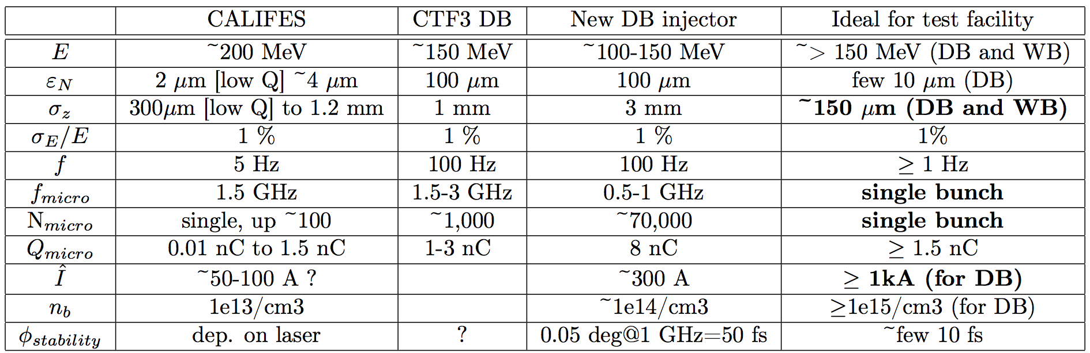
Plasma wake-field, CTF3 parameters
E. Adli – Oslo University
Even at n₀ ~ 10¹⁴ /cm³ the DB and WB bunches must be shorter than what is currently available in CTF3.
On the next slides I will show a few PIC simulations where I use parameters based on the new DB injector as plasma DB, and CALIFES as plasma WB. Bunches is shortened as much as needed. Bunch shortening in CTF3 can be performed by new bunch compressors.

Slide 34
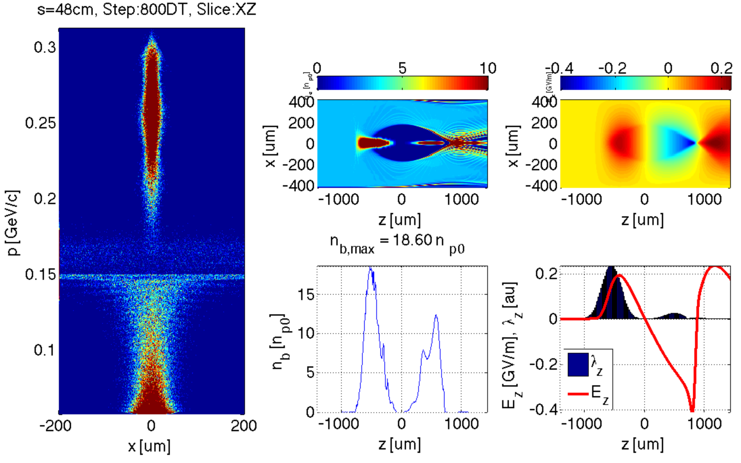
DB optimized parameters
E. Adli – Oslo University
In this scenario, the blow-out is clean until the full drive beam depletion. Excellent emittance preservation of the WB is predicted by the simulations.
σ_{z} = {150, 150} um
n₀ = 3.1 x 10¹⁴/cm3
ε_{zN,DB} = 10 um
s = 0.5 m
DB and WB must be shortened to about 150 um
DB emittance must be reduced to about 10 um

Slide 35
Summary of requirements for PWFA@CTF3
E. Adli – Oslo University
Two independent co-linear electron beams: ~adjustable relative timing with accuracy of ~10 fs
Required upgrades to CALIFES :
  <~ 150 um bunch length
  as large single bunch charge as possible (ideal is >~ 1 nC, but this is not a hard requirement)
Required upgrades to the DB
  <~ 150 um bunch length
  >~ 100 MeV beam energy
  <~ 10 um normalized emittances (linked to other parameters, like peak current; to be further studied)
  possibility to extract single shot (to be studied further)
Required upgrades to CTF3 complex
  Installation of plasma cell and diagnostics
  Co-linear injection/extraction (energy based)

Slide 36
PWFA - Conclusions
E. Adli – Oslo University
In order to demonstrate the feasibility of plasma for accelerator applications, there is need for additional test facilities.
CTF3 has potential to perform plasma experiments; relevant to a PWFA-LC. Complementary to AWAKE. Some overlap with FACET-II, FF. The more precise we can control and diagnose bunches, the more attractive CTF3 is.
Unique possibility to do multi-bunch plasma heating experiments possible (up to 1 GHz)
Bunches would need to be compressed by a significant factor
Single bunch capabilities for the DB strongly desired
We are interested in further developing this proposal with CLIC/CTF3

Slide 37











X-band technology for FELs
G. D’Auria – Elettra Trieste
XbFEL is a collaboration among several laboratories
aimed at promoting the development of X-band technology for FEL based photon sources.
ST Elettra - Sincrotrone Trieste, Italy.
CERN CERN Geneva, Switzerland.
JU Jagiellonian University, Krakow, Poland.
STFC Daresbury Laboratory Cockcroft Institute, Daresbury, UK
SINAP Shangai Institute of Applied Physics, Shanghai, China.
VDL VDL ETG T&D B.V., Eindhoven, Netherlands.
OSLO University of Oslo, Norway.
IASA National Technical University of Athens, Greece.
UU Uppsala University, Uppsala, Sweden.
ASLS Australian Synchrotron, Clayton, Australia.
UA-IAT Institute of Accelerator Technologies, Ankara, Turkey.
ULANC Lancaster University, Lancaster, UK.

Slide 38
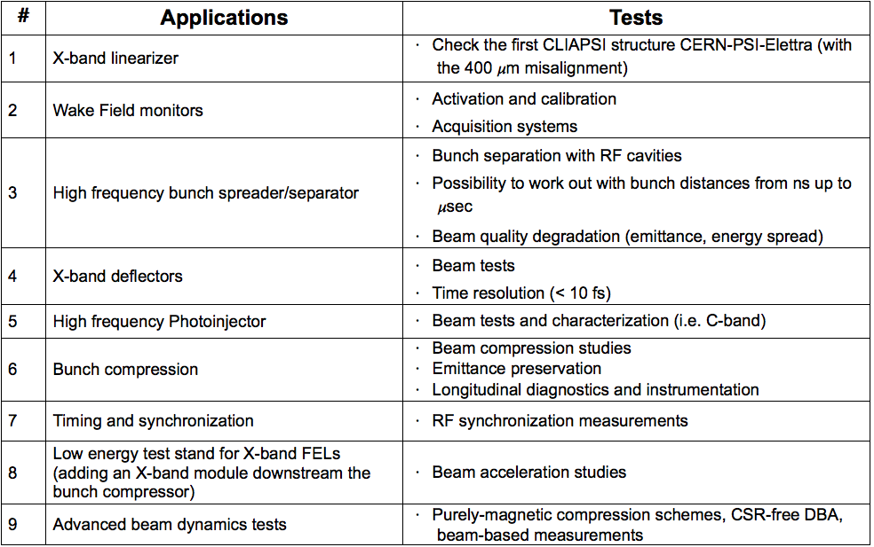
Potential tests for an X-band FEL using the CALIFES beam
New hardware required
Hardware already available
A. Latina (CERN) with relevant inputs from
G. D’Auria, S. Di Mitri (ELETTRA), M. Pedrozzi (PSI),
A. Dexter and G. Burt (Cockcroft, Lancaster)

Slide 39

  Extension of CALIFES for XFEL oriented developments.
  Problematic:
  Accessibility to the accelerator facility for beam dynamics and hardware
  developments is extremely limited on FEL user facilities, running 24/7 for production
  Ideal requirements for CALIFES:
  S-Band RF-Photoinjector system: high brightness beam could require some optimization of the lattice and the laser system (SITF experience is a good guideline)
  S-Band injector linac (~200-250 MeV)
  X-band longitudinal Phase space linearization (one cavity is sufficient)
  Magnetic chicane for compression: PSI could lend the mechanics, the connecting long vacuum chambers and eventually the magnets of the SITF compressor (12m long, angle adjustable between 0° and 5°)
  S-Band deflector system for slice measurements
  Optics + high resolution COTR insensitive transverse monitor for emittance measurements: SITF design (R. Ischebeck) and experience could be used
  Study ideas:
  Study of short pulse regime: CSR effects and development of instrumentation (in particular longitudinal)
  Test of new generation RF photo injectors: for example S-band coaxial or C-Band (advanced design available at PSI)
  Development and test with beam of X-band deflector systems (post undulator instrumentation)
  Test of X-Band acceleration modules with beam: RF aspects, alignment issues, short and long range wake.
  Study of HOM coupler for alignment purposes (cavity + electronics): one CLIAPSI cavity available at CERN, electronic development ongoing at PSI (M. Dehler)
  If enough space available
  Demonstration of non-linear magnetic compression with negative R56 and adjustable T566. Preliminary design study available at PSI (A. Streun). Required ~30 m and multipole magnets. Complex but:
  X-band linearization not required, one important source of jitter removed ⇒ increases of compression stability.
M. Dehler, M. Pedrozzi, M. Leich – PSI
Courtesy of M. Pedrozzi, M. Dehler, M. Leich

Slide 40
Advanced Beam Physics
S. Di Mitri – Elettra Trieste
Compare the performances of a purely-magnetic compression scheme, w.r.t. one including velocity bunching, both in terms of macroscopic properties of the beam as well as in terms of micro-bunching
Micro-bunching gain measurements and comparison with analytical models
Electron beam shot-noise bunching suppression + lasing (some undulators would be needed)
Tests of Double-Bend Achromat (DBA) with CSR suppression
Electron comb generation using masks in a dispersive region, and transport control
Tests of bunch compression with sextupoles in the dispersive region (verify the impact on the longitudinal phase space)
Measurement of emittance scaling with the photo-injector charge (models predict a shift from power of ½ to 1/3 but needs more accurate studies)

Slide 41
Shaping ability of Masks
W. Gai – Argonne
Multiple masks used to study bunch shaping
Before Mask
Apply
Mask
PARMELA Simulation results
Horizontal profile after the mask
Final current profile

Slide 42
Bunch length flexibility
In many cases a (very) short bunch length is required
May be accessible using a magnetic chicane or dogleg (need some compression studies, implications on off-crest phase, short range wake-fields)
Other possibility, RF deflector + collimator (crabbing). May also implement a two-deflector solution (RF bump) to remove crabbing
Should continue bunch compression studies in CALIFES 2015-2016 with streak camera, EOS and possibly RF deflector

Slide 43
Other flexibility requirements
Flexibility for single bunch / multibunch operation
Flexibility in bunch charge – if high charge is needed, a switch between CALIFES gun and PHIN is still possible?
Need of double pulse (drive + probe) for impedance/wake-fields measurements (and possibly plasma applications?). Flexibility in drive/probe bunch distance and independent control of transverse position/bunch charge may be critical aspects.

Slide 44
Conclusions
CTF3 in its present configuration will complete its program by end 2016 and stop operation
There is a strong interest by the CLIC collaboration in keep using some of its hardware and infrastructure beyond 2016
  Drive beam front-end
  Dogleg beam loading experiment
  RF testing (Xbox1, S band)
  CALIFES for equipment testing
In particular CALIFES may be a reasonably cheap multi-purpose test facility
  Useful within the CLIC study – potentially much wider interest
  Clear synergies with other projects/labs may help in gathering resources and support
  CALIFES will be extremely useful already in its present form, but staged upgrades will enhance flexibility/usefulness
Will develop an integrated proposal including cost/resource assessment and evaluation of scientific case of the different options

Slide 45
THANKS for your attention

Slide 46
Summary of (some) possible upgrades
Keep CALIFES for beam instrumentation test
  Add an available S-band klystron, modify waveguides
  Add a chicane, another dedicated klystron for deflector
  Change the deflector to a CR one
  Closed RF bump + collimator for bunch length control
  (Switch for the PHIN gun for higher charge)
(Push the beam line toward the X-Box1 in CTF2)
Or transport the 12 GHz power to CLEX
  Add a 12 GHz crab cavity for bunch length diagnostic
  (Add an undulator, a Compton scattering experiment…)
Produce special beams for Impedance/Wakefield studies
  2 bunches of different energies with adjustable delay
  Single bunch, short range wakes

Slide 47
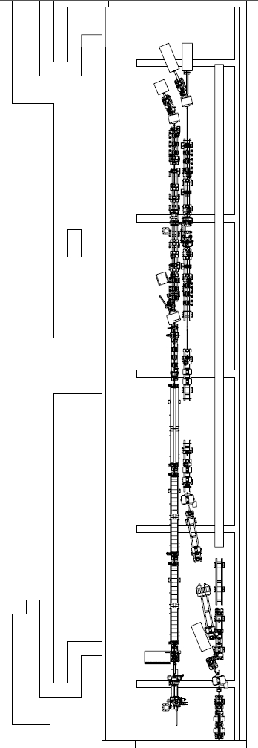
Previous studies – the Instrumentation Beam Line
A preliminary study has been done: “Short Pulse Capabilities of the Instrumentation Beam Line – V. Ziemann – 6 May 2010”
  Short pulses (200 fs – 35 μm) are necessary to mimic the CLIC main beam for instrumentation tests
  Pulses of 20 μm are achievable with a chicane R₅₆ = 2 cm and energy encoding of 10⁻³ , maximum energy reduced to 78% of the on-crest one
Other option ➔ four-bend chicane
All equipment will be available from the DB lines (magnets, powers, chambers…)

Slide 48
Some consideration on resources
Given the present CTF3 material budget/manpower, one may roughly evaluate the resources needed to keep CALIFES running after 2016 to about:
  200-300 kCHF/year (including M to P – students and PJAS)
  About 5 FTEs (staff and fellows)
The above would include a minimum upgrade (1 ½ additional klystron, rearrangement of test area)
Must do a more precise evaluation for the more ambitious upgrade options

Slide 49
Beam parameters
CTF3 Drive beam (present)
  4 A, 1 us pulses (trains of 1-3 nC bunches, 1.5/3 GHz spacing)
  rep rate 1-50 Hz
  50 – 125 MeV
  May provide lower energy (>10 MeV), need to study transport
  Typical beam sizes 1 × 1 mm, may easily fill round chamber, 4 cm diameter.
CTF3 Drive beam (new Front-End)
  4 A, up to 140 us pulses (trains of 1-6 nC bunches, 0.5/1 GHz spacing)
  rep rate 1-50 Hz
  10 – 100 MeV
  Typical beam sizes 1 × 1 mm, may easily fill round chamber, 4 cm diameter.

Slide 50
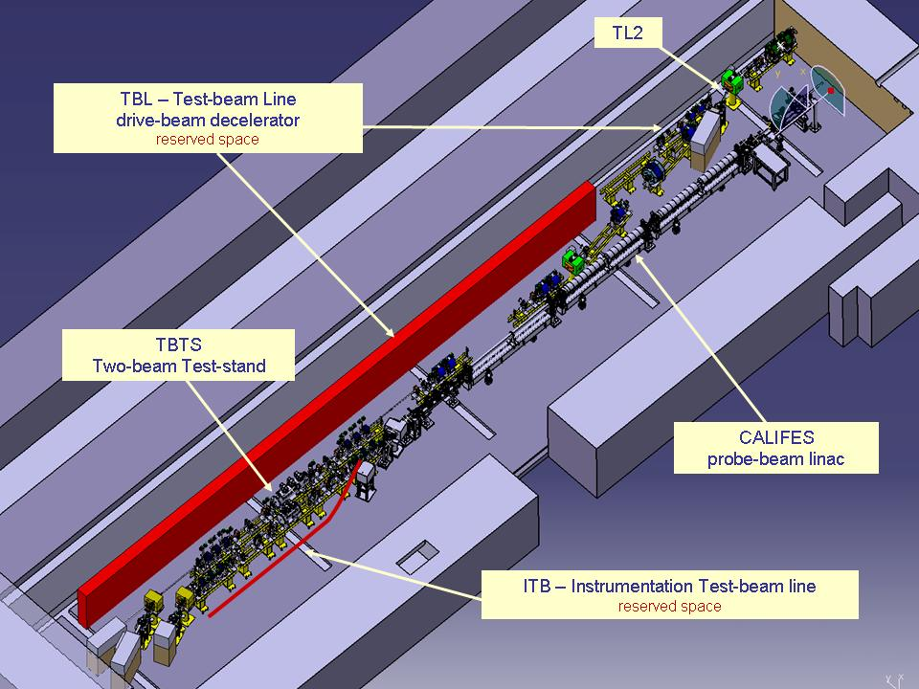


CALIFES hall & infrastructure
Convenient hall (42 x 8 x 2.6 m³) with proper concrete shielding (2.8 m) and large access.
Instrumentation & klystron gallery just above
An up-to-date Laser lab, (80 m laser beam line, partly under vacuum)
Fully equipped (conditioned air, water, access control. No crane.
CLEX

Slide 51

JUICE - CALIFES
T. Lefevre – M. Brugger
JUICE (JUpiter ICy moons Explorer) Mission
  http://sci.esa.int/juice/55055-juice-mission-gets-green-light-for-next-stage-of-development/
  Launch a mission in 2022 to explore Jupiter and its potentially habitable icy moons
  Strong electron cloud environment around Jupiter
    Need to test components to electron irradiation
  ESA-CERN Collaboration Agreement
    Involvement and support of CERN KT group
Turning CALIFES in an Electron Irradiation facility
  Both for Total Integrated Dose and Single Event Effect
  Beam energy ranging from 10-200MeV
  Large irradiation area (5x5cm minimum)
  Required fluence of 10⁷/10⁸ electron/cm²
  1st test in 2015
Perspectives for e- beam irradiation tests in CTF3/CALIFES – R. Corsini, ESA visit @CERN https://indico.cern.ch/event/357271/
Challenges for CALIFES
Run at (much) lower beam energy (down to 10MeV)
  New RF acceleration scenario (to be tested)
  New test Area in CALIFES after the Gun or after 1st Acc. Structure
Need very low flux and large and homogeneous irradiation area
  Need to qualify the beam quality (possibly cutting tails with collimators ultimately)
  Characterization and 1st testing possible on CALIFES Dump line

Slide 52
Open issues/questions
Verify needed fluxes (test pieces, needed area…)
Energy range – how critical? Verify low energy capabilities in CALIFES.
How uniform should be the beam?
What about the time structure (average vs. peak flux)?
Total dose needed, testing time, running scenario…
Layout of irradiation region – activation of collimator, air activation, dump…
Timescale (before and/or after 2016)
…

Slide 53


Uniform beam - Filling the aperture
Beam Pipe
Test area
Collimator

Slide 54
Fluxes
1 nC pulses @ 1 Hz (CALIFES, few bunches)
    6.25 10⁹ e⁻ s⁻¹
Assume round beam, 40 mm x 40 mm, 90% cut
    5 10⁷ e⁻ cm⁻² s⁻¹

Slide 55

Longitudinal wake-fields
A. Latina - Measurement of
Short-Range Longitudinal
Wakefields at CALIFES
Longitudinal wakes cause energy loss and correlated energy spread (chirp)
Idea:
1. Compensate the correlated energy spread with small off-crest acceleration, and measure the energy spread using a
spectrometer
2. Perform a phase / voltage scan
to locate the minimum
(i.e. compensation)
3. Infer wake-field characteristics from
- energy spread vs phase scan,
- energy spread vs voltage scan

Slide 56
Setup, parameters, and simulation of phase scan
CALIFES-like parameters:
Two CLIC AS with a/λ = 0.11
Bunch charge = 1 nC
Average energy = 200 MeV
Two bunch configurations considered:
Bunch uncorrelated espread = 0.25 %
Bunch length = 1200 um
and:
Bunch uncorrelated espread = 0.5 %
Bunch length = 600 um
Four different longitudinal distributions
Gaussian
Uniform
Forward
Backward
The plots show the result energy spread:

Slide 57


Dependence on voltage is much weaker
Example: 1.2 mm bunch length, 0.2% energy spread, two distributions
Uniform
Resolution required ~5 keV
Gaussian:
- Resolution required ~ 1 keV

Slide 58


Slide 59
Additional considerations II
Decommissioning ≠ zero resources !
It may be wise to “mothball” CTF3, also to keep open the possibility to re-start CTF3 after 2016 if needed (new module generation?) and according to CERN priorities
Hovever, this clashes with requests to re-use CTF3 buildings and equipment…
The shut-down paradox:
“Given an accelerator facility, the cost of running it is in general lower or equal than the cost of a shut-down”.
G. McMonagle

Slide 60


CALIFES
Parameters | Specified | Verified | Comment
Energy | 200 MeV | 205 MeV | Without bunch compression
Norm. emittance | < 20 π mm.mrad | 4 π mm.mrad | With reduced bunch charge
Energy spread | < ± 2 % | ± 0.5 %
Bunch charge | 0.6 nC | 0.65 nC | With new photocathode
Bunch spacing | 0.667 ns | 0.667 ns | Laser driven
Nb of bunches | 1-32-226 | from 1 to 300 | Limited by RF pulse length
rms. bunch length | < 0.75 ps | 1-2 ps and above
Repetition rate | 0.8 – 5 Hz | 0.8 – 5 Hz | Upgrade possibility to 10 Hz
CALIFES
Swiss FEL injector (courtesy Simona Bettoni)
Up to now used on TBTS, from November: ➔ Two-Beam module
Growing activities over the last years on beam diagnostic/components testing

Slide 61



Beam Diagnostic Tests in CLEX
Electro-optic bunch profile monitor
in CALIFES
(CERN-Dundee University)
Stripline Drive Beam BPM in TBL
(CERN-LAPP)
Cavity Main Beam BPM
in CALIFES/TBTS
(CERN-JAI at Royal Holloway)

Slide 62
X-band
CALIFES may provide an unique opportunity to test X-band structures/modules with beam
XBOX1 located very close (distance comparable to present low-loss line for dog-leg beam loading experiment)
Straight-forward solution: connect to XBOX1 for beam testing in CLEX
An upgraded CALIFES beam may be not too far from what is needed for FELs: “Playing ground” for X-band FEL beam studies and developments
Future possibility: test a full X-band module (for X-band FEL or klystron-based CLIC) – may need an additional modulator/klystron
Add more? …

Slide 63
Layouts?
26.5 m
42 m
4.7 m
Stand Alone Test Stand
8 m
26.5 m
42 m
4.7 m
Low loss circular waveguide
Stand Alone Test Stand
8 m

Slide 64
Options
Lepton Injector Chain
Dog-leg
CALIFES
facility
DB Front End

Slide 65

CTF3 Decommissioning issues
G. McMonagle

Slide 66
CTF3 Decommissioning & re-use issues
G. McMonagle
Simplest solution close the complex and lock the doors
Continue running CTF3
  Costs
    New access control system needed
    Upgrade of modulator controls (get rid of non supported CAMAC)
    manpower
Reuse the Linac and rings for electron injector to PS
  Costs
    New access control system needed
    Upgrade of modulator controls (get rid of non supported CAMAC)
    manpower
CLEX
  Keep CALIFES operational
    New access control system needed SOLVED
New DB injector test area
    Use LINAC area but probably need civil engineering work in CTF2 area to allow modulators and klystrons to be installed (too large for gallery)
CTF2
  Continued PHIN tests, X band test area
    New access system needed SOLVED

Slide 67

Yearly cost of CTF3 running
2012 running, relevant budget codes in blue
Include some consolidation and upgrade

Slide 68

Yearly cost of CTF3 running
Spent 2013
(kCHF)
340
13
170
26
890 (1200)
58
50
Taking out upgrades, divided by sub-systems
1550 (1860)
+ Manpower: about 15 FTE, including M to P

Slide 69
Contribution to AWAKE
Awake needs 20 MeV electron source with low charge, small emittance and possibly short bunches
One CTF3-type Klystron-Modulator would be needed to power the injector
PHIN (Califes) type gun could be used
Some diagnostics, vacuum equipment and magnets might be useful
CTF-team experience would be likely helpful as well
Test facility and pre-commissioning in CTF2 area?

