Slide 1
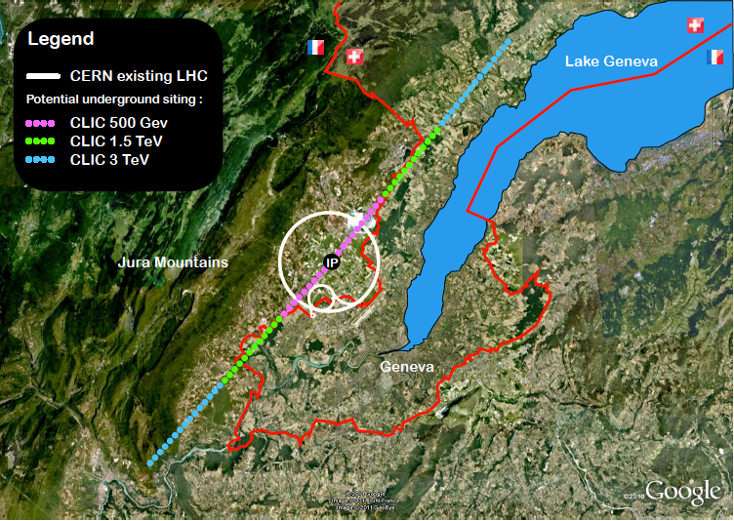
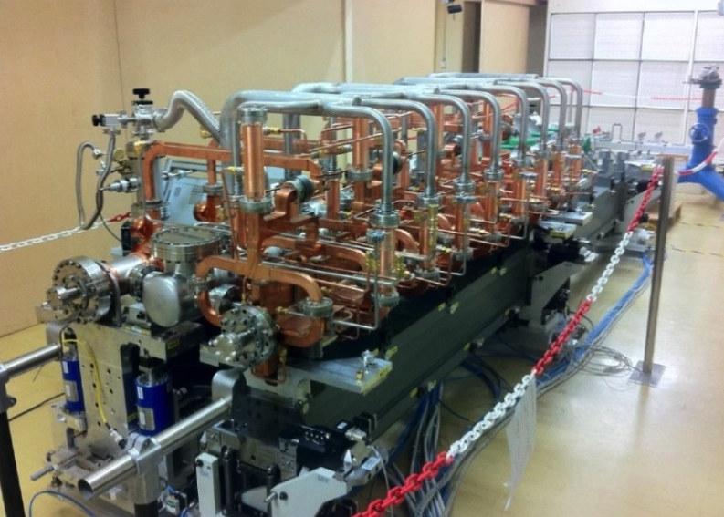
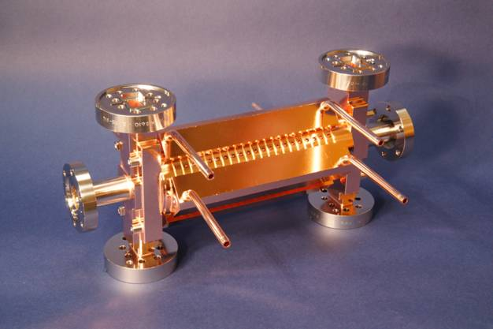
The CLIC project
Outline:
- Brief introduction
- Across the main activities (2014-2015)
- Brief summary
Key features:
High gradient (energy/length)
Small beams (luminosity)
Repetition rates and bunch spacing (experimental conditions)

Slide 2

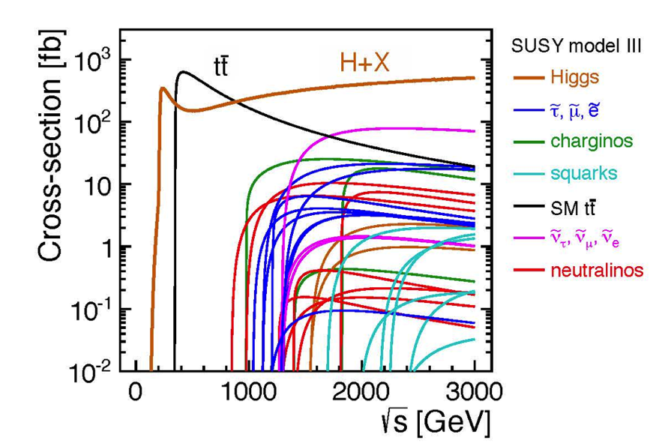
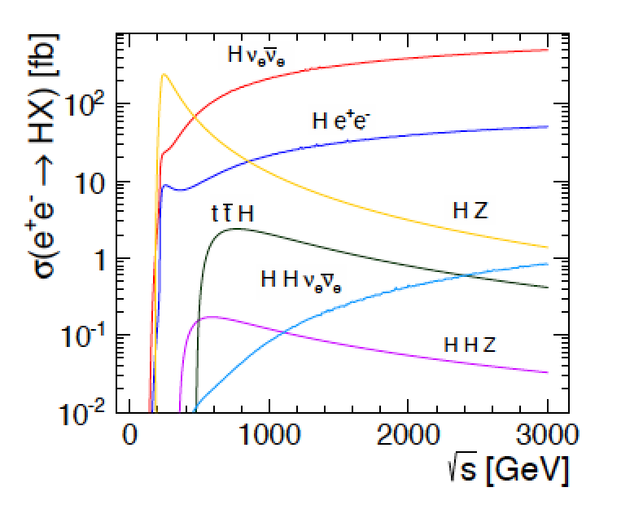
Physics at a LC from 250 GeV to 3000 GeV
Physics case for the Linear Collider:
  Higgs physics (SM and non-SM)
  Top
  SUSY
  Higgs strong interactions
  New Z’ sector
  Contact interactions
  Extra dimensions
  …. AOP (any other physics) …
Specific challenges for CLIC studies:
Need to address Higgs-studies, including gains for measurements at higher energies
Reach for various “new physics” (list above) options; comparative studies with HiLumi LHC and proton-proton at higher energies (FCC).
References:
CLIC CDR and
http://arxiv.org/pdf/hep-ex/0112004.pdf

Slide 3
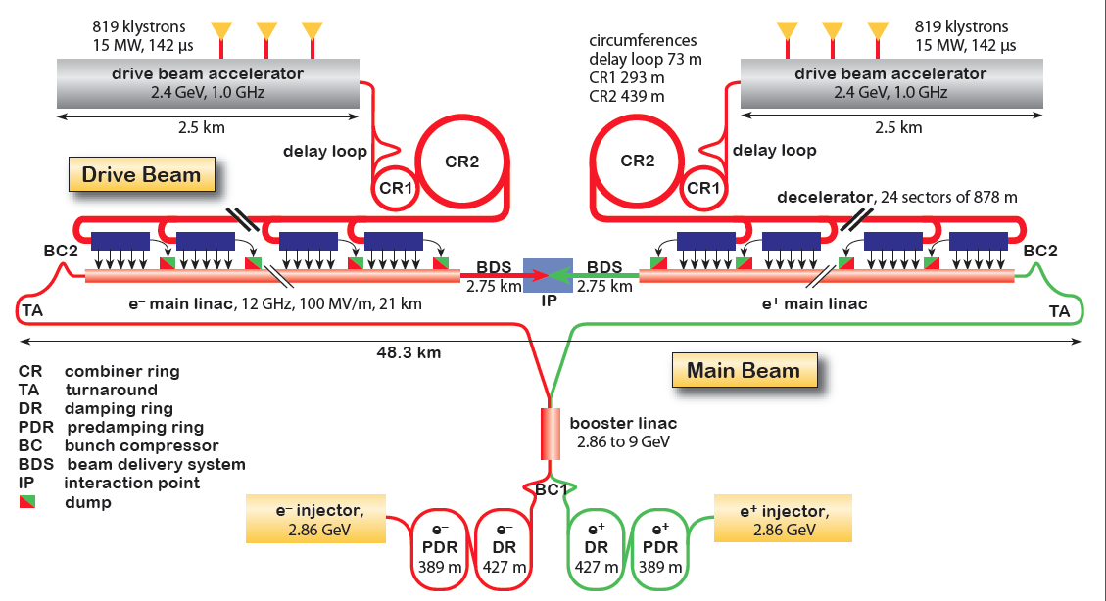
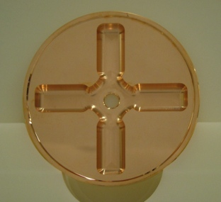
CLIC Layout at 3 TeV
Drive Beam Generation Complex
Drive beam time structure - initial
Drive beam time structure - final
240 ns
240 ns
5.8 μs
140 μs train length - 24 × 24 sub-pulses
4.2 A - 2.4 GeV – 60 cm between bunches
24 pulses – 101 A – 2.5 cm between bunches
Main Beam Generation Complex

Slide 4
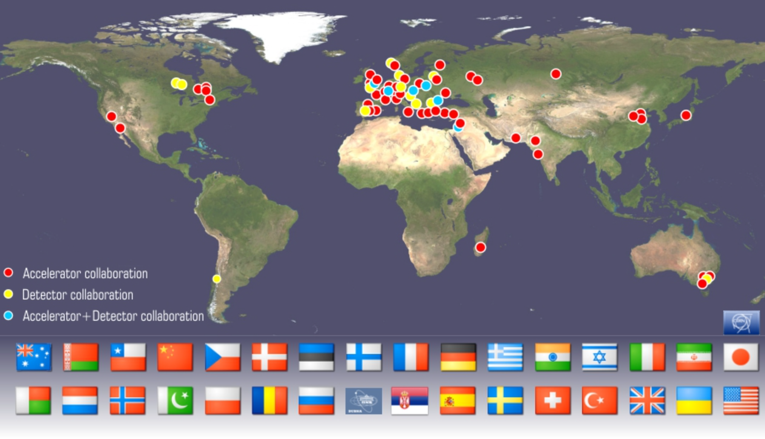
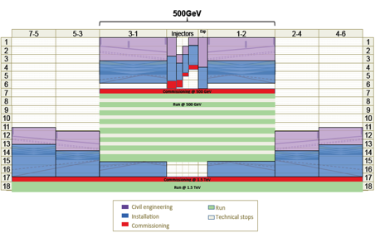
Accelerator collaboration with ~50 institutes
New institutes are joining:
In 2014 SINAP Shanghai and IPM Tehran
Detector collaboration operative with ~25 institutes
2013-18 Development Phase
Develop a Project Plan for a staged implementation in agreement with LHC findings; further technical developments with industry, performance studies for accelerator parts and systems, as well as for detectors.
4-5 year Preparation Phase
Finalise implementation parameters, Drive Beam Facility and other system verifications, site authorisation and preparation for industrial procurement.
Prepare detailed Technical Proposals for the detector-systems.
Construction Phase
Stage 1 construction of CLIC, in parallel with detector construction.
Preparation for implementation of further stages.
Common work with ILC related to several acc. systems as part of the LC coll., also related to initial stage physics and detector developments
Common physics benchmarking with FCC pp and common detect. challenges (ex: timing, granularity), as well as project implementation studies (costs, power, infrastructures …)
2018-19 Decisions
On the basis of LHC data
and Project Plans (for CLIC and other potential projects as FCC), take decisions about next project(s) at the Energy Frontier.
2024-25 Construction Start
Ready for full construction
and main tunnel excavation.
Commissioning
Becoming ready for data-taking as the LHC programme reaches completion.

Slide 5
Main activities
Parameters, Design and Implementation
Feedback Design, Background, Polarization
Machine Protection & Operational Scenarios
Electron and positron sources
Damping Rings
Ring-To-Main-Linac
Main Linac - Two-Beam Acceleration
Beam Delivery System
Machine-Detector Interface (MDI) activities
Drive Beam Complex
Experimental verification
Drive Beam phase feed-forward and feedbacks
Two-Beam module string, test with beam
Drive-beam front end including modulator development and injector
Modulator development, magnet converters
Drive Beam Photo Injector
Low emittance ring tests
Accelerator Beam System Tests (ATF and FACET, others)
X-band Technologies
X-band Rf structure Production
X-band Rf structure High Power Testing
Novel RF unit developments (high efficiency)
Installation and Operation of High power Testing Facilities
Basic High Gradient R&D
Technical Developments
Survey & Alignment
Quadrupole Stability
Warm Magnet Prototypes
Beam Instrumentation and Control
Two-Beam module development
Beam Intercepting Devices
Controls
Vacuum Systems
Beam Transport Equipment
Integrated Baseline Design and Parameters
X-band Rf structure Design
Damping Rings Superconducting Wiggler
Cost, power, schedule, stages
Detector and Physics
Physics studies and benchmarking
Detector optimisation
Technical developments
Integrated Modeling and Performance Studies
CTF3 Consollidation & Upgrades
http://clic-study.web.cern.ch/content/clic-accelerator-activities
Covered this afternoon in talk by Eva Sicking

Slide 6
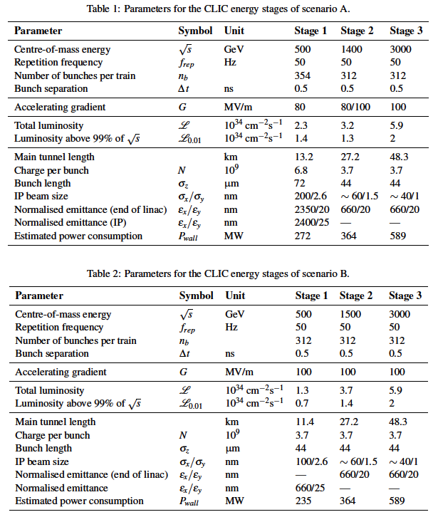
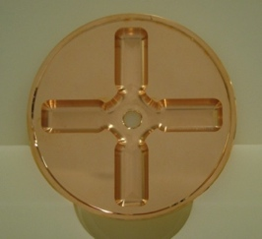
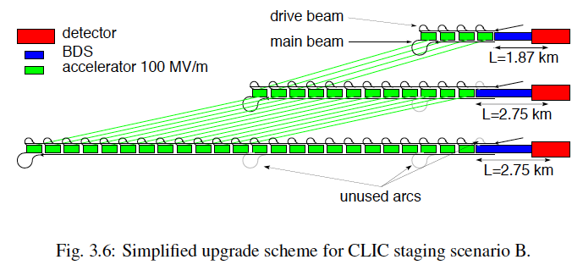
Possible CLIC stages studied in the CDR
Key features:
High gradient (energy/length)
Small beams (luminosity)
Repetition rates and bunch spacing (experimental conditions)

Slide 7
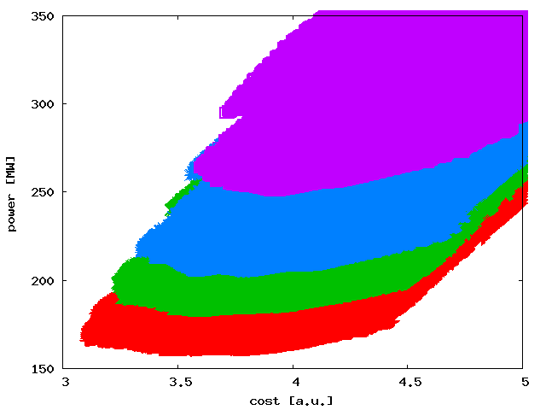
Cost/power: Design/parameters & Technical developments
Beyond the parameter optimization there are other on-going developments (design/technical developments):
Use of permanent or hybrid magnets for the drive beam (order of 50’000 magnets)
Optimize drive beam accelerator klystron system
Electron pre-damping ring can be removed with good electron injector
Dimension drive beam accelerator building and infrastructure are for 3 TeV, dimension to 1.5 TeV results in large saving
Systematic optimization of injector complex linacs in preparation
Power consumption:
  Optimize and reduce overhead estimates
6.5
Automatic procedure scanning over many structures (parameter sets)
Structure design fixed by few parameters
a₁,a₂,d₁,d₂,N_{c},f,G
Beam parameters derived automatically
Cost calculated – and power
L=0.5x10³⁴cm⁻²s⁻¹
L=1.0x10³⁴cm⁻²s⁻¹
L=2.0x10³⁴cm⁻²s⁻¹
L=1.0x10³⁴cm⁻²s⁻¹
L=1.25x10³⁴cm⁻²s⁻¹
L=1.5x10³⁴cm⁻²s⁻¹
L=2.0x10³⁴cm⁻²s⁻¹
S=1.1
Goal:
Rebaseline project at ~350 GeV, ~1.5 TeV, 3 TeV, very close to concluding this (talks in Friday plenary)
Next natural steps: Optimised cost and power for given luminosity
Hopefully needed to redo with new LHC results at some point
Luminosity goal significantly impact minimum cost
For L=1x10³⁴cm⁻²s⁻¹ to L=2x10³⁴cm⁻²s⁻¹ :
Costs 0.5 a.u. and O(100MW)
Cheapest machine is close to lowest power consumption
12
N [10⁹]

Slide 8
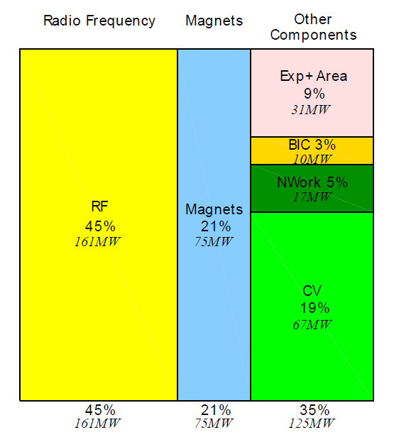
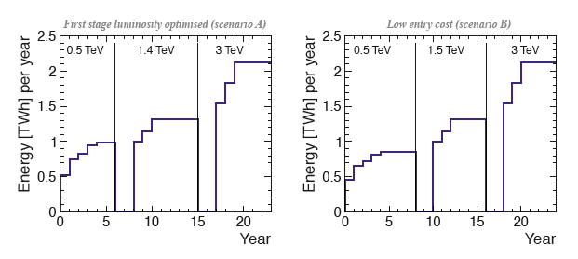
e+/e- Colliders: P_{AC} vs E_{CM}
Power reductions are being looked at:
Design and parameters – optimise power
Look at key components – magnets
Klystron and modulator efficiences
Optimisation
Recover energy
Consider where the power is dissipated (distributed or central)
Look at daily and yearly fluctuation – can one run in “low general demand” periods
Understand and minimize the energy (consider also standby, MD, down periods, running scenarios
CERN energy consumption 2012: 1.35 TWh
8

Slide 9
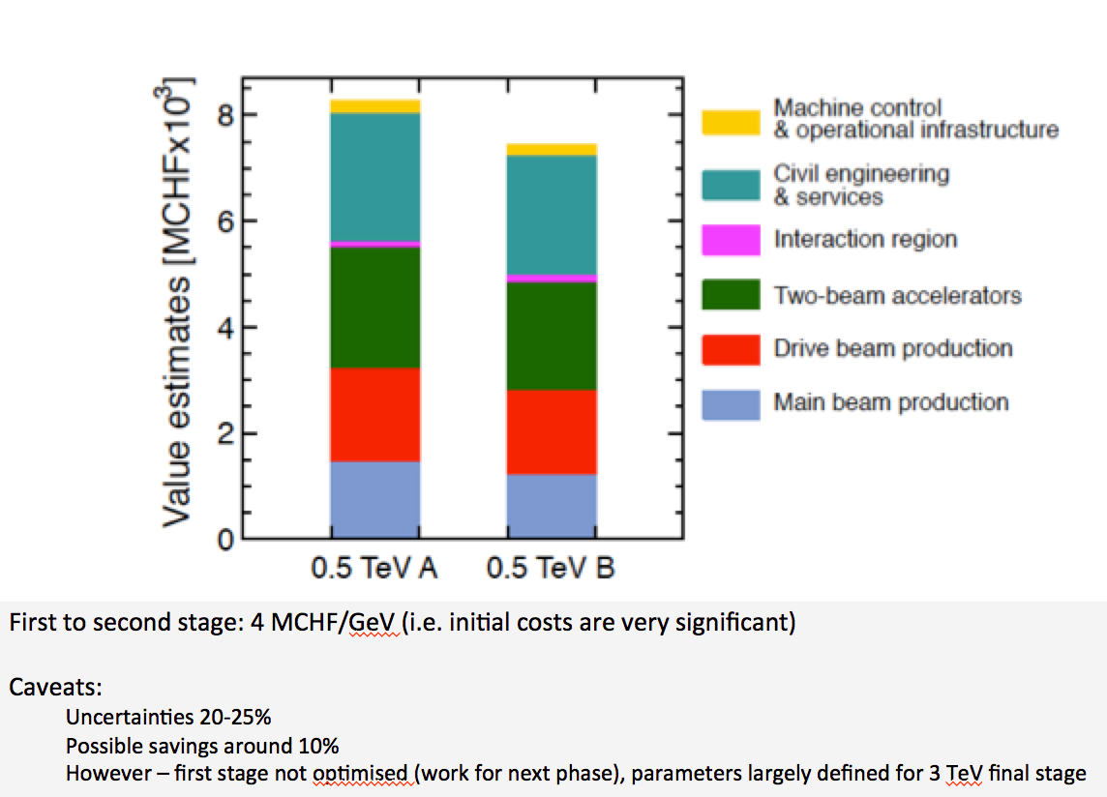
Developments for costs
CDR costs can now be updated
New parameters optimizing costs, affect mostly initial stages
Technical developments, affects all stages
Too early for updated industrial quotes in some areas (other areas can be updated)
2012 CHF versus 2015 CHF ?

Slide 10
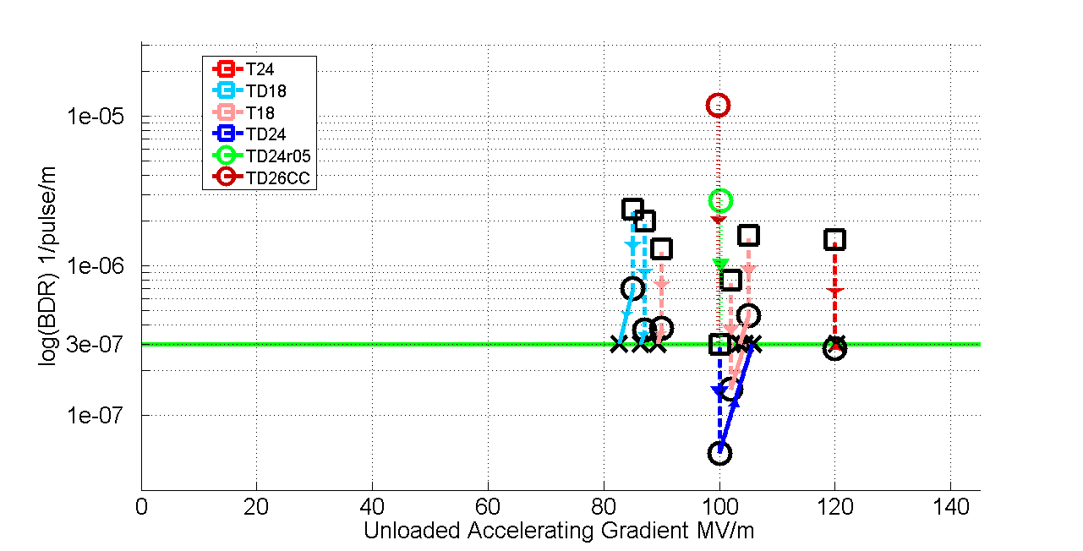
High-gradient accel. structure test status
Results very good, design/performance more and more understood – but:
numbers limited, industrial productions also limited
basic understanding of BD mechanics improving
condition time/acceptance tests need more work
use for other applications (e.g. FELs) needs verification in coming years
In all cases test-capacity is crucial

Slide 11
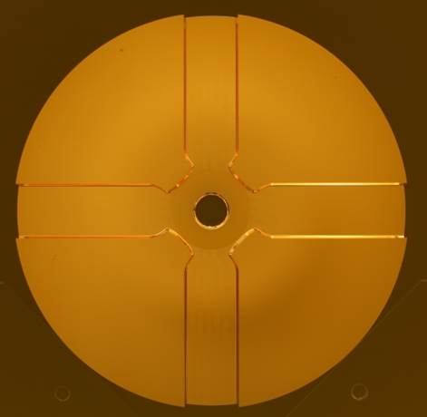
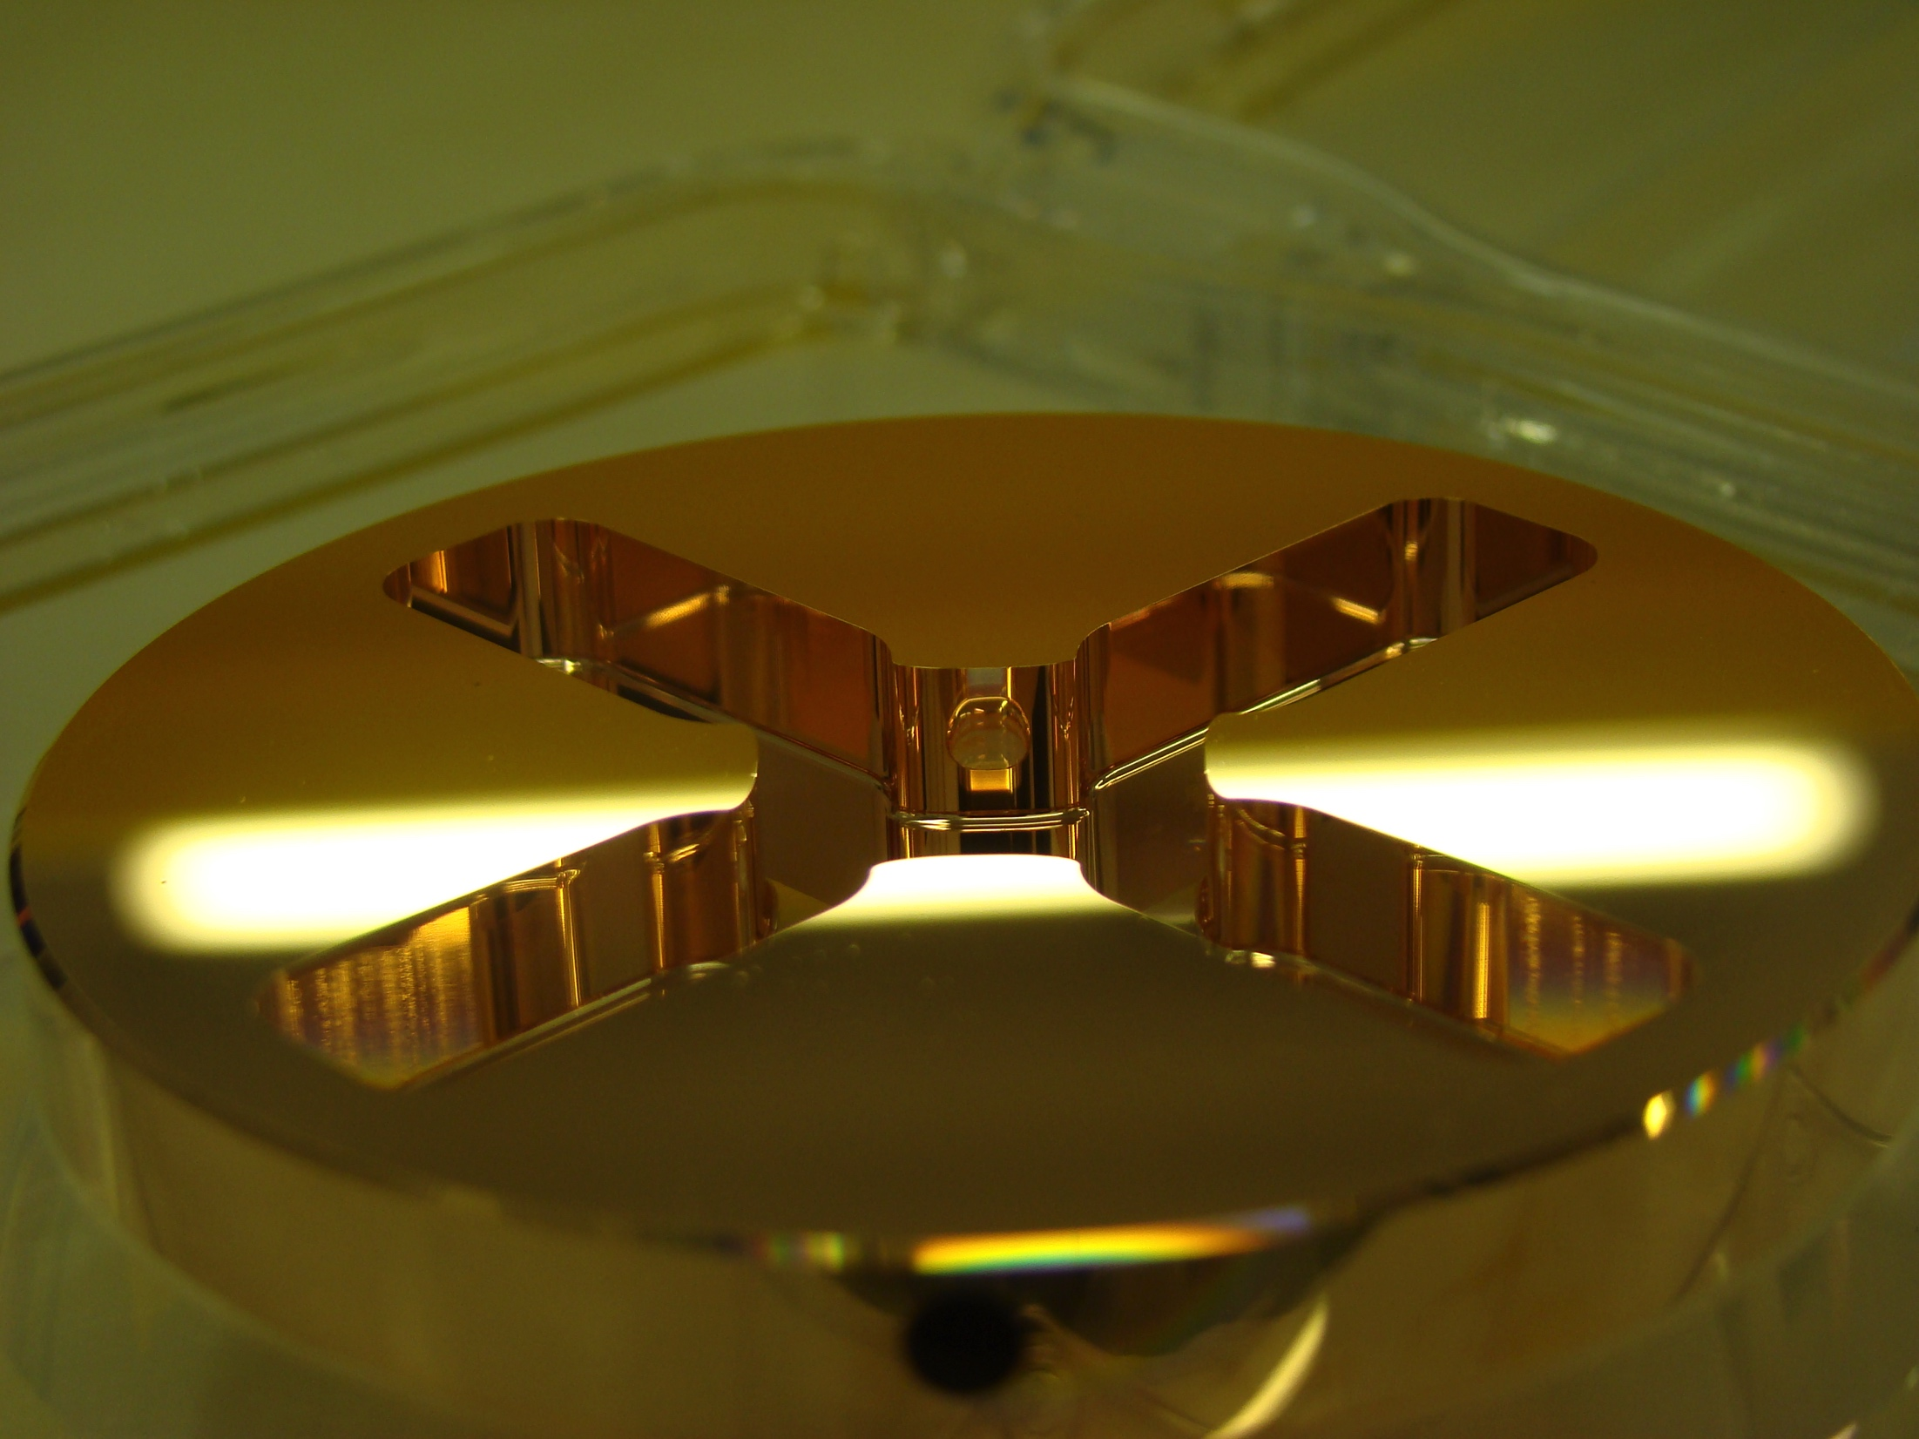

X-band structures and testing
X-band Technologies:
High gradient structures and high efficiency RF (structure prod. in green)
X-band High power Testing Facilities (x3 increase) (in red)
Use of X-band technologies for FELs
VDL
CERN
PSI
CIEMAT
SLAC
◉
◉
◉
KEK
◉
Tsinghua
SINAP
◉
◉
◉
◉
◉
◉
◉
8

Slide 12
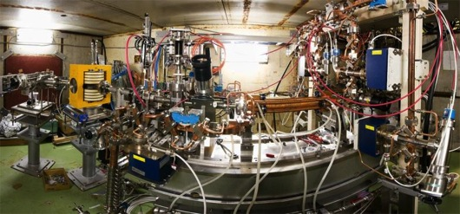
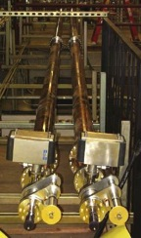
X-band test-stands
Previous:
Scaled 11.4 GHz
tests at SLAC and KEK.
NEXTEF at KEK
ASTA at SLAC
… remain important, also linked to testing of X-band structures from Tsinghua and SINAP
Very significant increase of test-capacity:
First commercial 12 GHz klystron systems available
Confidence that one can design for good (and possibly better) gradient performance
As a result: now possible to use Xband technology in accelerator systems – at smaller scale

Slide 13
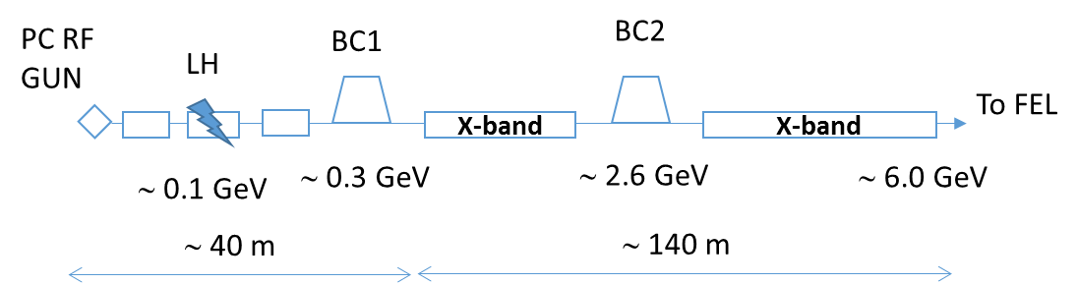
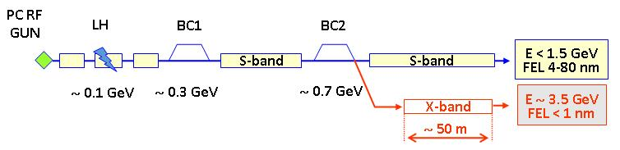
Xband facilities - FELs
X-band technology appears interesting for compact, relatively low cost FELs – new or extensions
  Logical step after S-band and C-band
  Example similar to SwissFEL: E=6 GeV, Ne=0.25 nC, σ_{z}=8μm
Use of X-band in other projects will support industrialisation
  They will be klystron-based, additional synergy with klystron-based first energy stage
Started to collaborate on use of X-band in FELs
  Australian Light Source, Turkish Accelerator Centre, Elettra, SINAP, Cockcroft Institute, TU Athens, U. Oslo, Uppsala University, CERN
Share common work between partners
  Cost model and optimisation
  Beam dynamics, e.g. beam-based alignment
  Accelerator systems, e.g. alignment, instrumentation…
Define common standard solutions
  Common RF component design, -> industry standard
  High repetition rate klystrons (200->400 Hz now into test-stands)
Important collaboration for X-band technology

Slide 14
Main activities
Parameters, Design and Implementation
Feedback Design, Background, Polarization
Machine Protection & Operational Scenarios
Electron and positron sources
Damping Rings
Ring-To-Main-Linac
Main Linac - Two-Beam Acceleration
Beam Delivery System
Machine-Detector Interface (MDI) activities
Drive Beam Complex
Experimental verification
Drive Beam phase feed-forward and feedbacks
Two-Beam module string, test with beam
Drive-beam front end including modulator development and injector
Modulator development, magnet converters
Drive Beam Photo Injector
Low emittance ring tests
Accelerator Beam System Tests (ATF and FACET, others)
X-band Technologies
X-band Rf structure Production
X-band Rf structure High Power Testing
Novel RF unit developments (high efficiency)
Creation and Operation of x-band High power Testing Facilities
Basic High Gradient R&D
Technical Developments
Survey & Alignment
Quadrupole Stability
Warm Magnet Prototypes
Beam Instrumentation and Control
Two-Beam module development
Beam Intercepting Devices
Controls
Vacuum Systems
Beam Transport Equipment
Integrated Baseline Design and Parameters
X-band Rf structure Design
Damping Rings Superconducting Wiggler
Cost, power, schedule, stages
Detector and Physics
Physics studies and benchmarking
Detector optimisation
Technical developments

Slide 15
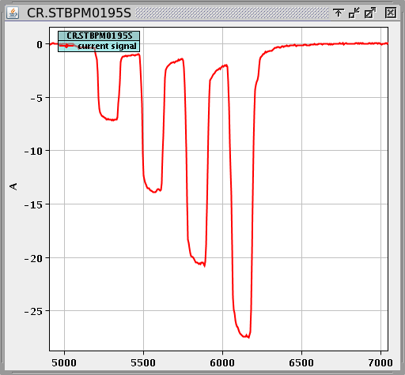
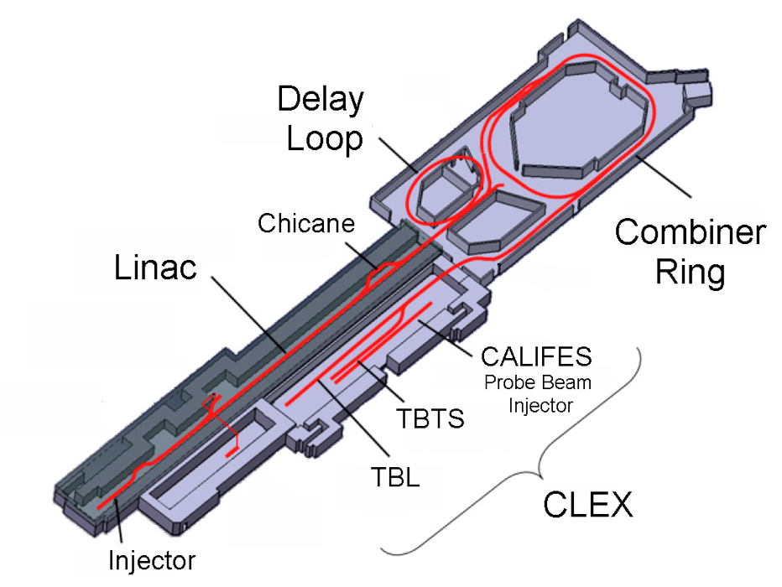
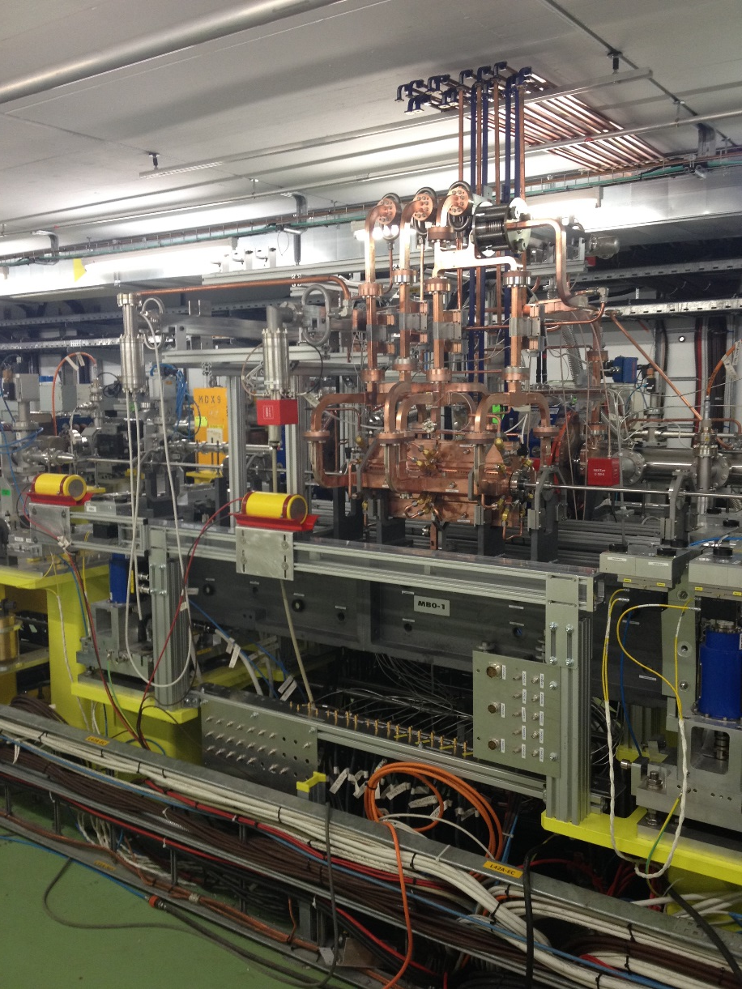
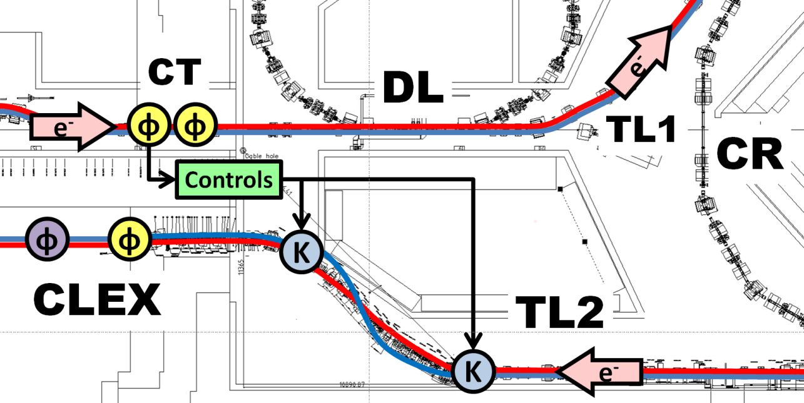
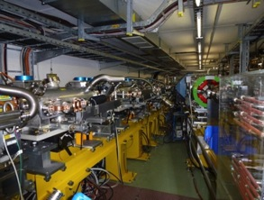
CTF3 programme 2013-2016
CLIC test facility - CTF3
1st turn
Beam loading/BDR
experiment
Combiner Ring
Dogleg experiment
Breakdown rate measurement with presence of beam-loading
12 GHz CLIC structure
powered by 12 GHz RF (Xbox)
1.2 A CTF3 e- beam
First result:
- beam has no negative result on breakdown rate
4th turn
Phase feed-forward,
DB stability studies
Two-Beam Module, Wake-field monitors, Two-beam studies
RF pulse shaping
Power production,
RF conditioning/testing with DB & further decelerator tests

Slide 16
CLIC system tests beyond CTF3
Drive beam development beyond CTF3
  RF unit prototype with industry using CLIC frequency and parameters
  Drive beam front-end (injector), to allow development into larger drivebeam facility beyond 2018
Damping rings
  Tests at existing damping rings, critical component development (e.g. wigglers) ... large common interests with light source laboratories
Main beam (see slide later)
  Steering tests at FACET, FERMI, …
Beam Delivery System (see slide later)
  ATF/ATF2

Slide 17
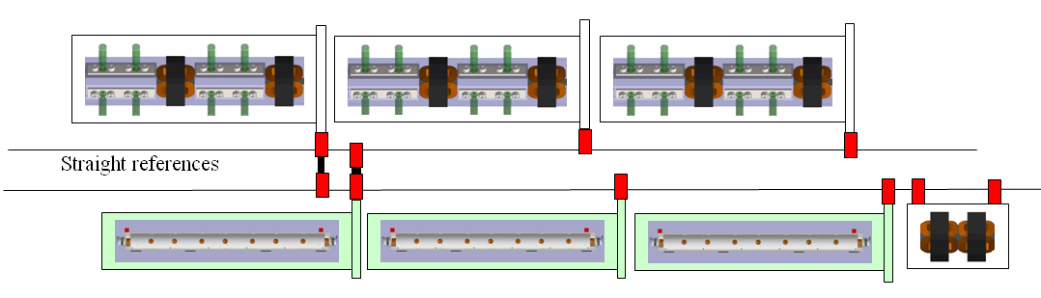
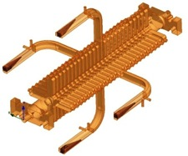
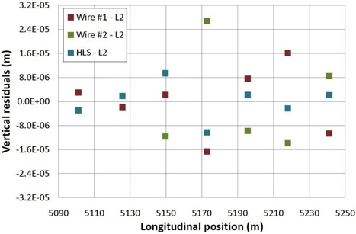
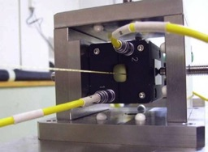
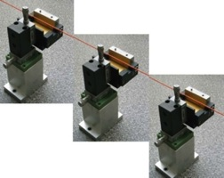
Main Linac Tolerances
Performance verifications – CLIC
Stabilise quadrupole
O(1nm) @ 1Hz
1) Pre-align BPMs+quads
accuracy O(10μm) over about 200m
3) Use wake-field monitors accuracy O(3.5μm) – CTF3
2) Beam-based alignment
Test of prototype shows
  vertical RMS error of 11μm
  i.e. accuracy is approx. 13.5μm

Slide 18
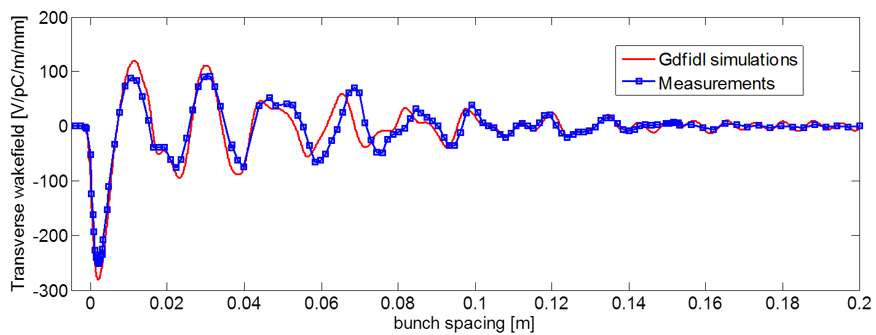
FACET measurements of wakefields
e-, NRTL
e+, Driven bunch
Dump
e-, Witness bunch
Dipole
Dipole
e+
Downstream BPMs
e-
CLIC-G TD26cc
Transverse offset
deflected orbit
e+, SRTL

Slide 19
ATF2: Stabilisation Experiment
The CLIC coll. is very interested in a longer term programme at ATF2 and ideas exist for:
Building 2 octupoles for ATF2 (to study FFS tuning with octupoles)
Test of OTR/ODR system at ATF2
Test and use of accurate kicker/amplifier system is considered
General support for ATF2 operation

Slide 20
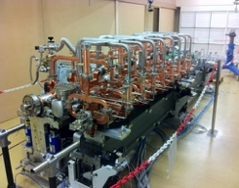
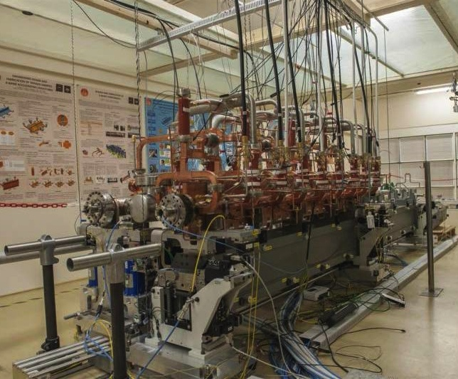
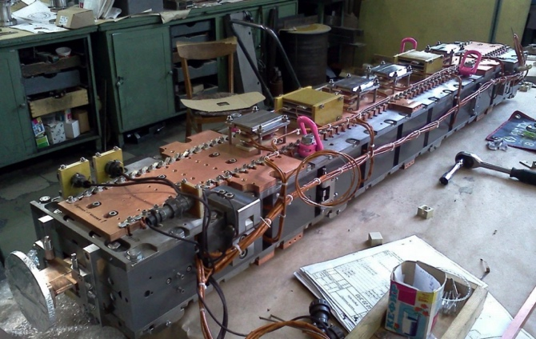
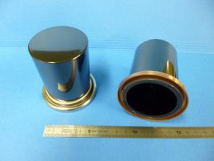
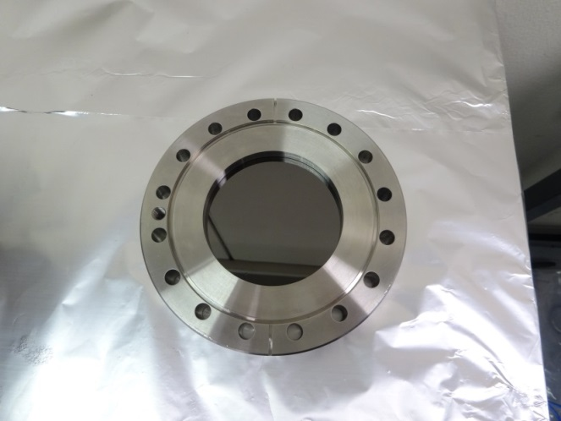
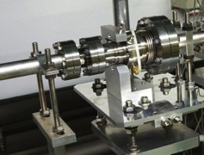
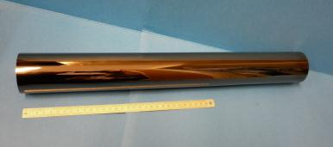
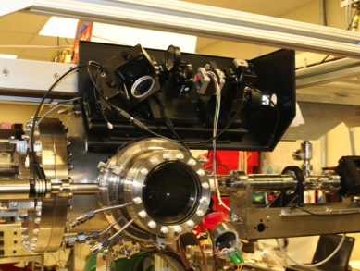
Technical activities – examples
Technical Developments are motivated by several possible reasons:
Key components for systemtests
Critical for machine performance
Aimed at cost or power reduction

Slide 21
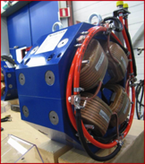
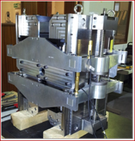
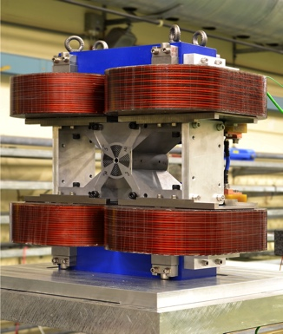
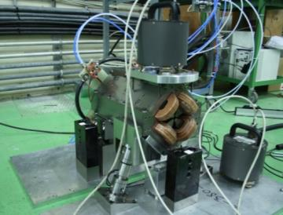
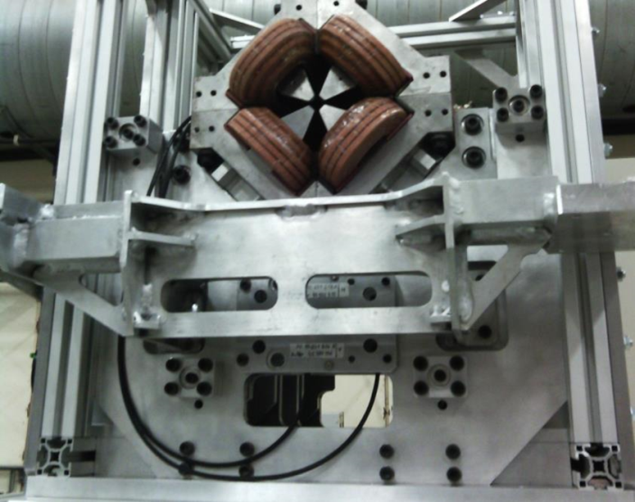

Slide 22

~260 registered (and ~200 talks)
Main elements:
Open high energy frontier session session (today)
Accelerator sessions focusing on collaboration efforts and plans 2015-2019, parallel sessions and plenary
High Gradient Applications for FELs, industry, medical
Physics and detector sessions on current and future activities
Collaboration and Institute Boards

Slide 23
Summary
The goals and plans for 2015-19 are well defined for CLIC, focusing on the high energy frontier capabilities – well aligned with current strategies – also preparing to align with LHC physics as it progresses in the coming years:
Aim provide optimized stages approach up to 3 TeV with costs and power not too excessive compared to LHC
Very positive progress on X-band technology, due to availability of power sources and increased understanding of structure design parameters
  Applications in smaller systems; FEL linacs key example – with considerable interesting in the CLIC collaboration
Also recent good progress on performance verifications, drivebeam, main beam emittance conservation and final focus studies
  BBA discussions, BDS/ATF important
  CTF3 running and plan until end 2016, strategy for systemtests beyond
Technical developments of key parts well underway – with increasing involvement of industry – largely limited by funding
Collaborations for CLIC accelerator and detector&physics studies are growing

Slide 24
Thanks
Slides/figures/advice from CLIC collaboration members Knowingly from L. Linssen, A. Latina, K.Kubo and ATF colleagues, D.Schulte, R.Corsini, W.Fang, W.Wuensch and X-band team, , F.Tecker, T.Lefevre, M.Modena, N.Catalan, C.Garion, H.Mainaud Durant and PACMAN team, R.Tomas, Y.Papaphilippou, G.D’Auria, … and several more unknowingly or indirectly

